Slide 1

Habitat Selection Analyses in R
2025-03-18
Brian J. Smith
Walker Field, Nate Rice

Slide 2
Schedule
9:00 – 9:30 Introductions
9:30 – 10:00 Terminology
10:00 – 11:00 RSFs
11:00 – 12:00 RSF Code Walkthrough
12:00 – 1:00 Lunch/RSF Exercise
1:00 – 1:30 RSF Exercise Review
1:30 – 2:00 Random Walks
2:00 – 3:00 SSFs
3:00 – 4:00 SSF Code Walkthrough
4:00 – 4:30 SSF Exercise
4:30 – 5:00 Lingering questions

Slide 3
Introductions

Slide 4

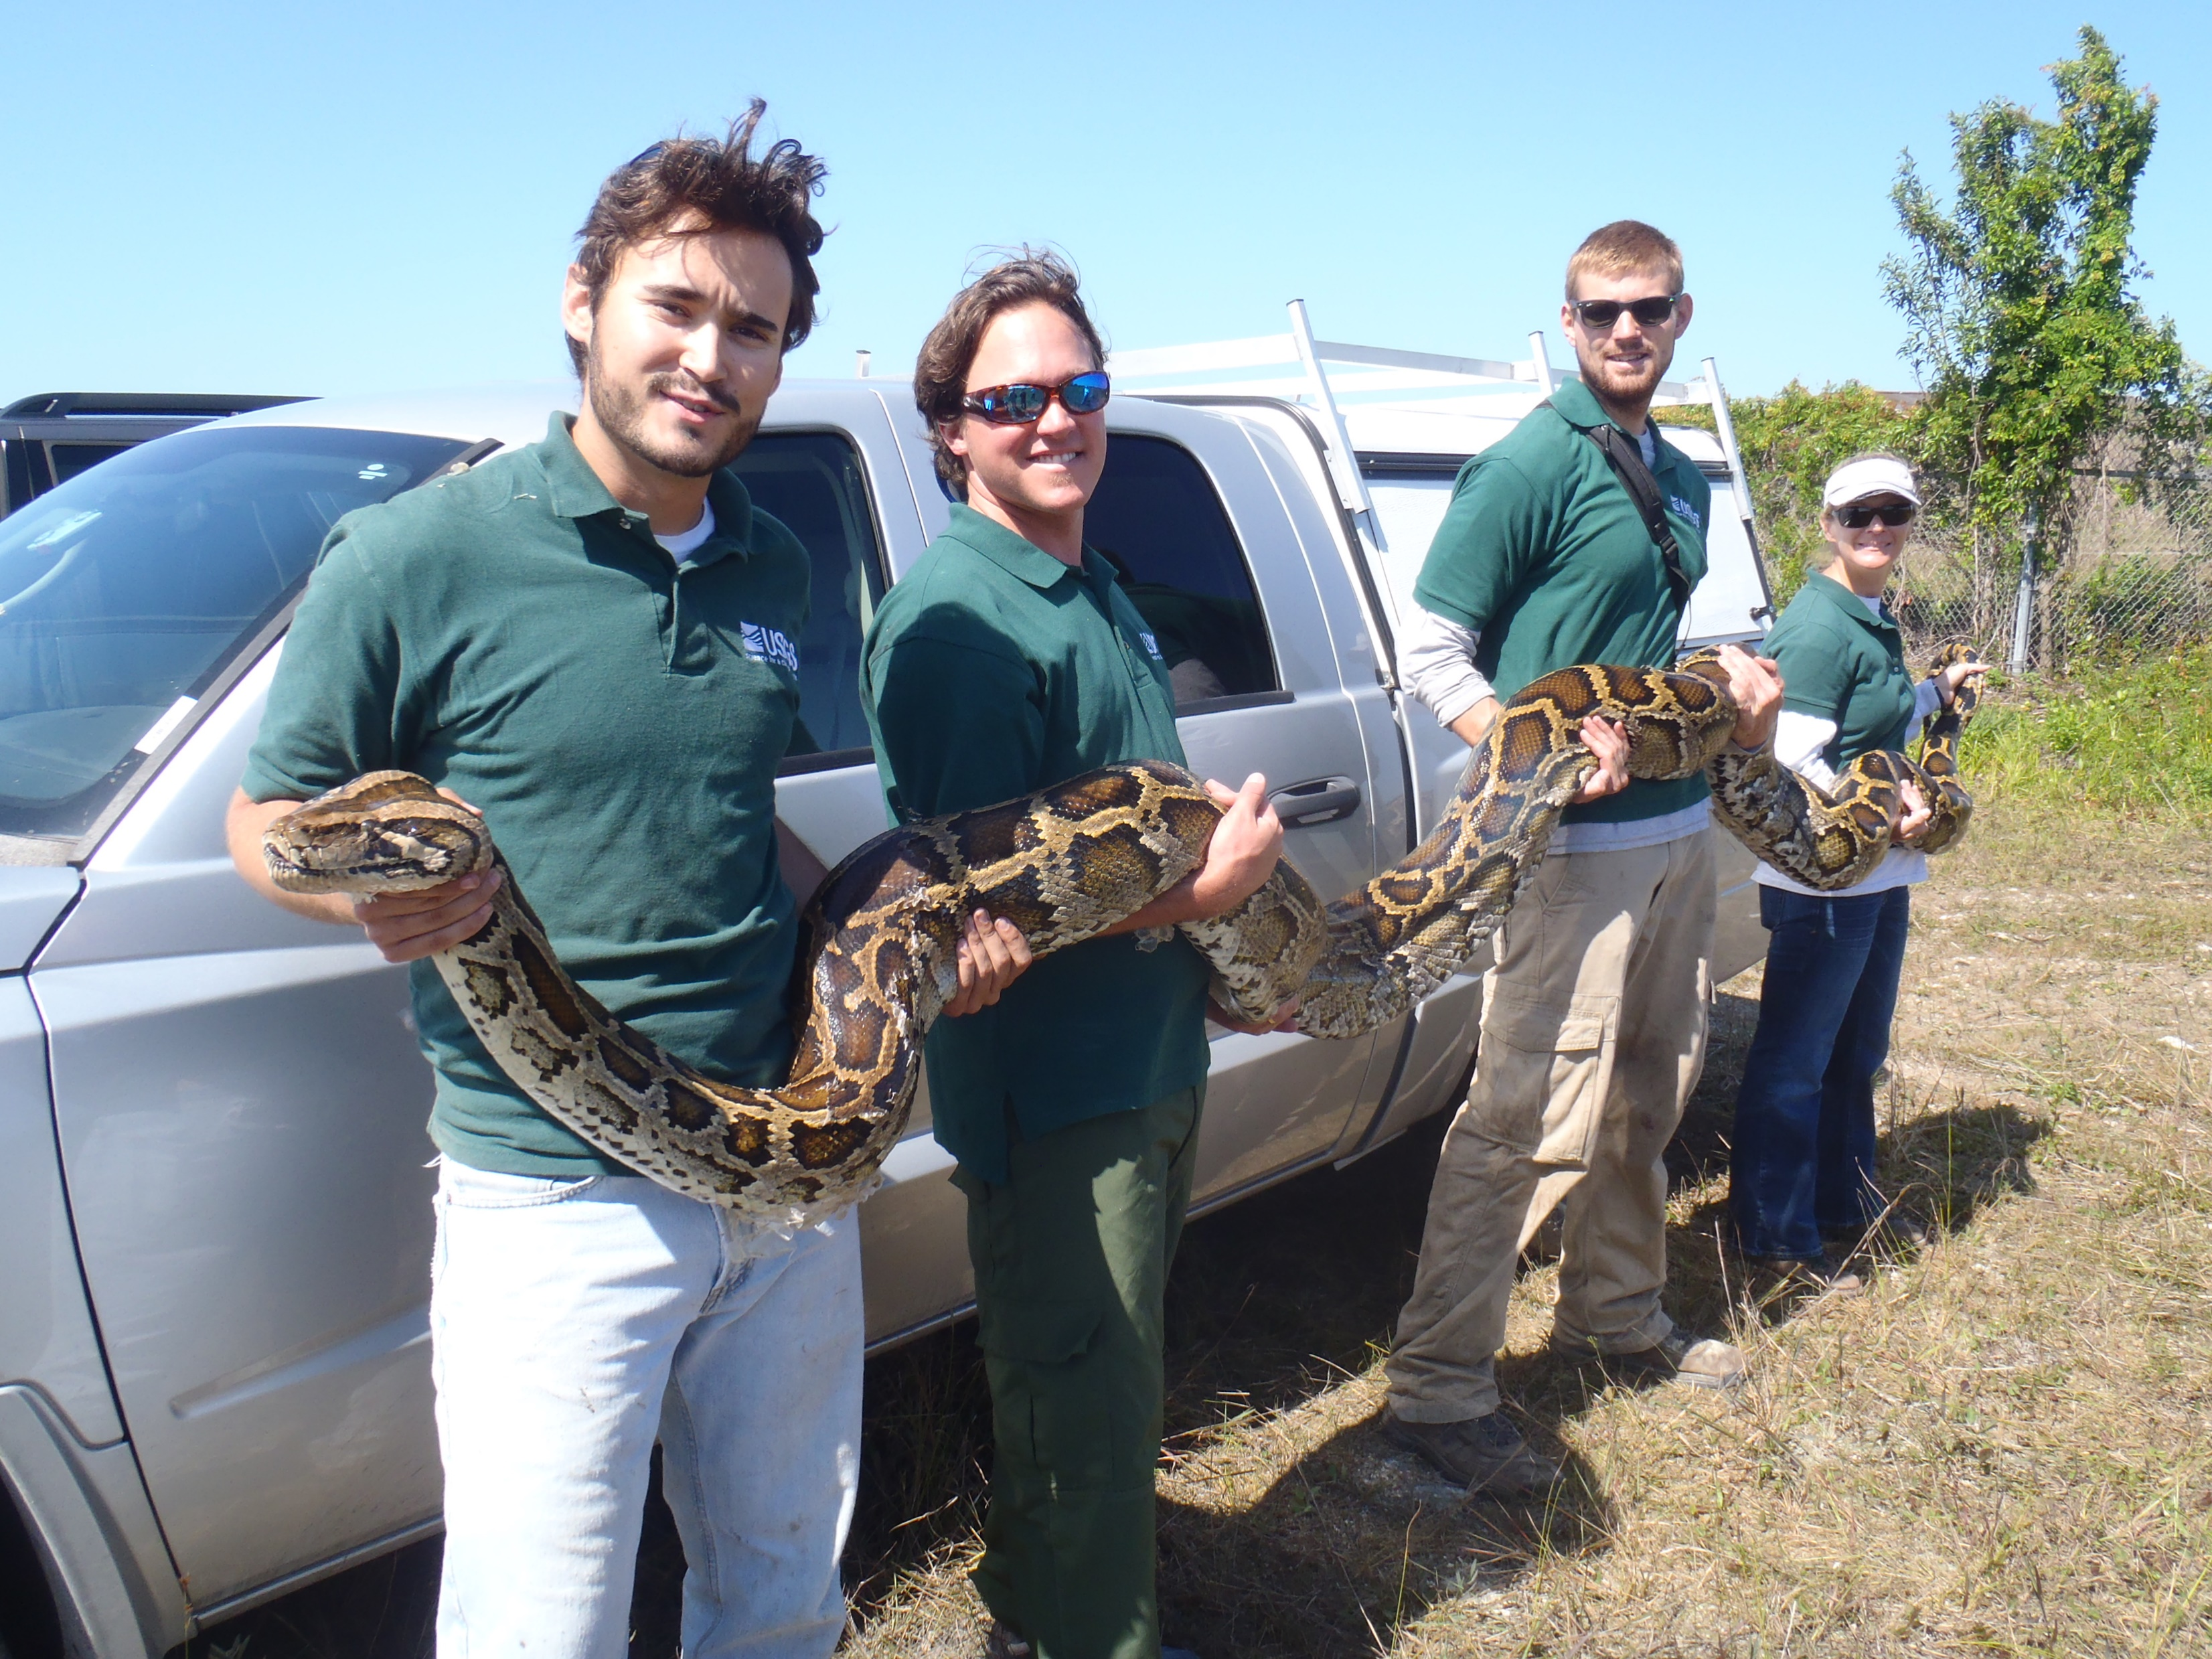
Brian Smith brian.smith@usu.edu
Notes:
Grew up in Florida. Worked out West for 2 summers before returning to FL and working in the Everglades for 9 years (incl MS).
M.S. at University of Florida, Thesis on Spatial Ecology of Burmese Pythons, Advised by Christina Romagosa
Ph.D. at Utah State University, Dissertation on Nonconsumptive Effects of Wolves/Cougars on Elk, Co-advised by Tal Avgar and Dan MacNulty

Slide 5

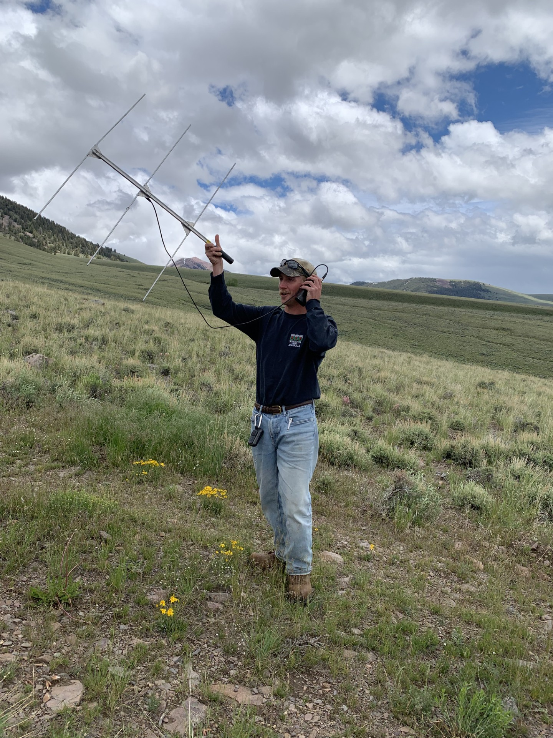
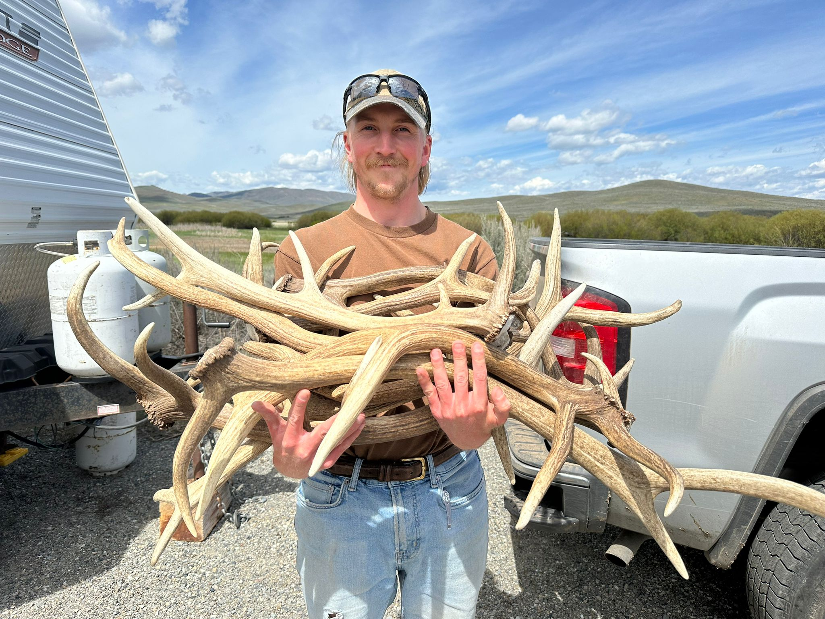
Walker Field wfield@uidaho.edu

Slide 6

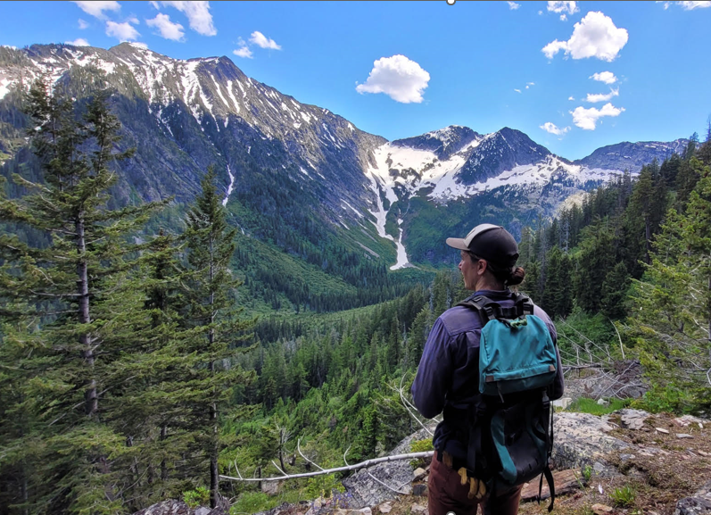

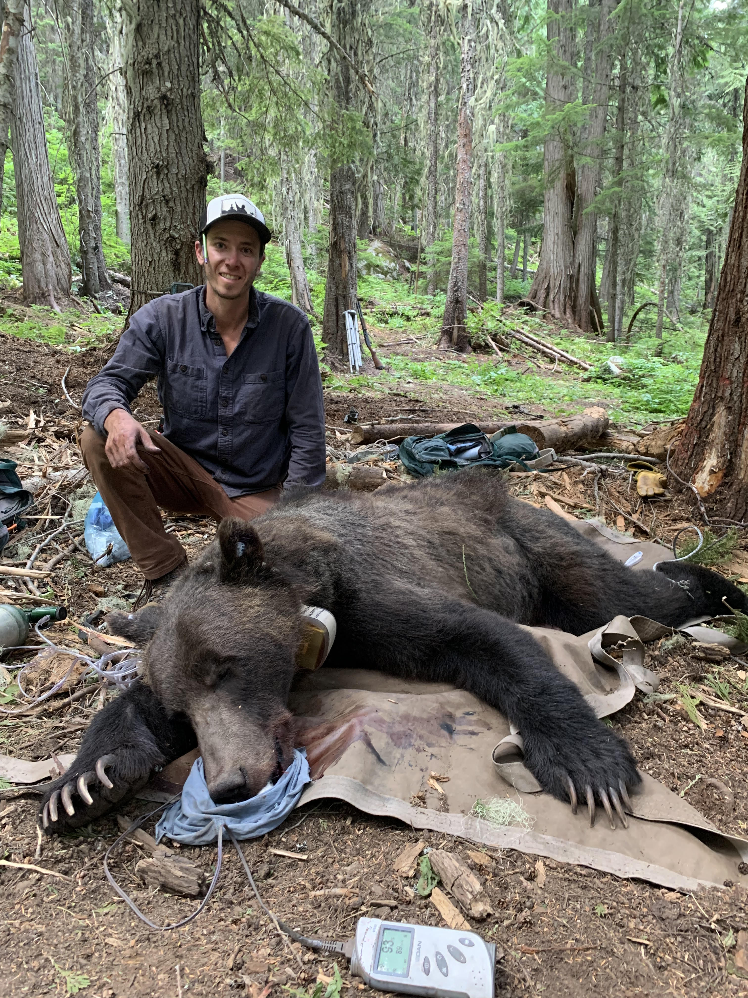
Nate Rice
nathanielr@uidaho.edu

Slide 7
About you
Where are you from?
What’s your current position?
Why are you interested in habitat selection analyses?
How much experience do you have with HSAs?

Slide 8
Preamble

Slide 9
Why is this so hard?
GIS Skills
Coordinate systems
Projections
Layers
Statistics
GLMs/GLMMs
Likelihood equivalence
Autocorrelation
Mathematics
Random walks
Trigonometry
Algebra/Calculus
Ecology
Intraspecific interactions
Interspecific interactions
Population feedback
Fitness consequences
Wildlife Management
Manipulating space use
Habitat management
Harvest management

Slide 10
Things We’re Not Covering
Habitat-selection adjacent
GIS skills
GPS data cleaning
Home ranges
Alternative movement models
Hidden Markov models
Continuous time models
Advanced habitat selection
Multiple instances, mixed models
Simulation from fitted SSF

Slide 11
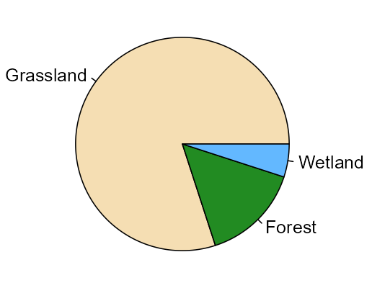
Roadmap
(i)SSFs
Notes:
We’re going to start from the simple perspective of used and available habitat classes.
We know we want to arrive at the fairly complex perspective of (i)SSFs.
The way there is long and winding.

Slide 12
Roadmap
Movement Models
RSFs
(aka HSFs)
(i)SSFs
Notes:
Along the way, we’ll build up to RSFs.
Then we need to bring in movement models from mathematics before we can understand SSFs.

Slide 13
Timeline
1995
2000
2005
2010
2015
2020
2024
Notes:
I’m going to try to give you the background and context chronologically on a timeline

Slide 14
Timeline
Fithian & Hastie 2013
Manly et al. 1993
Forester et al. 2009
Michelot et al. 2024
Arthur et al. 1996
1995
2000
2005
2010
2015
2020
2024
Fortin et al. 2005
Avgar et al. 2016
Aebischer et al. 1993
Warton & Shepherd 2010
Notes:
Eventually we’ll build up this timeline and arrive at a modern perspective on SSFs.

Slide 15
Terminology
Notes:
<9:30 – 9:30>

Slide 16

https://doi.org/10.24926/2020.081320

Slide 17
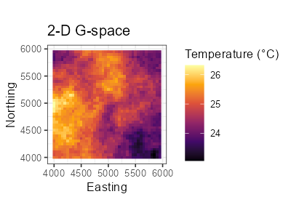
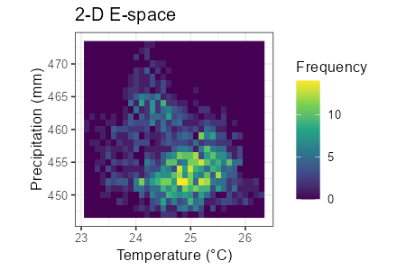
G-space vs. E-space
Geographic Space
Environmental Space
The space defined by physical dimensions, e.g., easting and northing or longitude and latitude.
The space defined by environmental variables, e.g., temperature and precipitation.

Slide 18
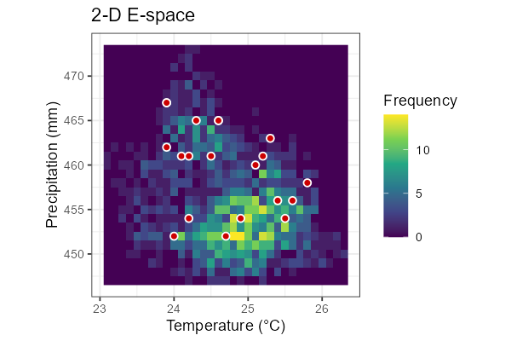
Habitat
A point in E-space defined by a set of environmental variables
(resources, risks, and conditions).

Slide 19
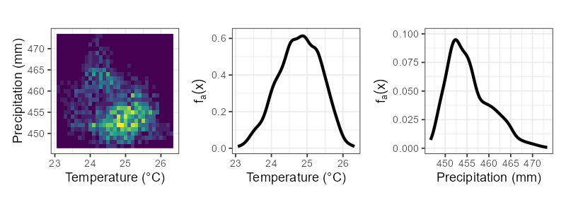
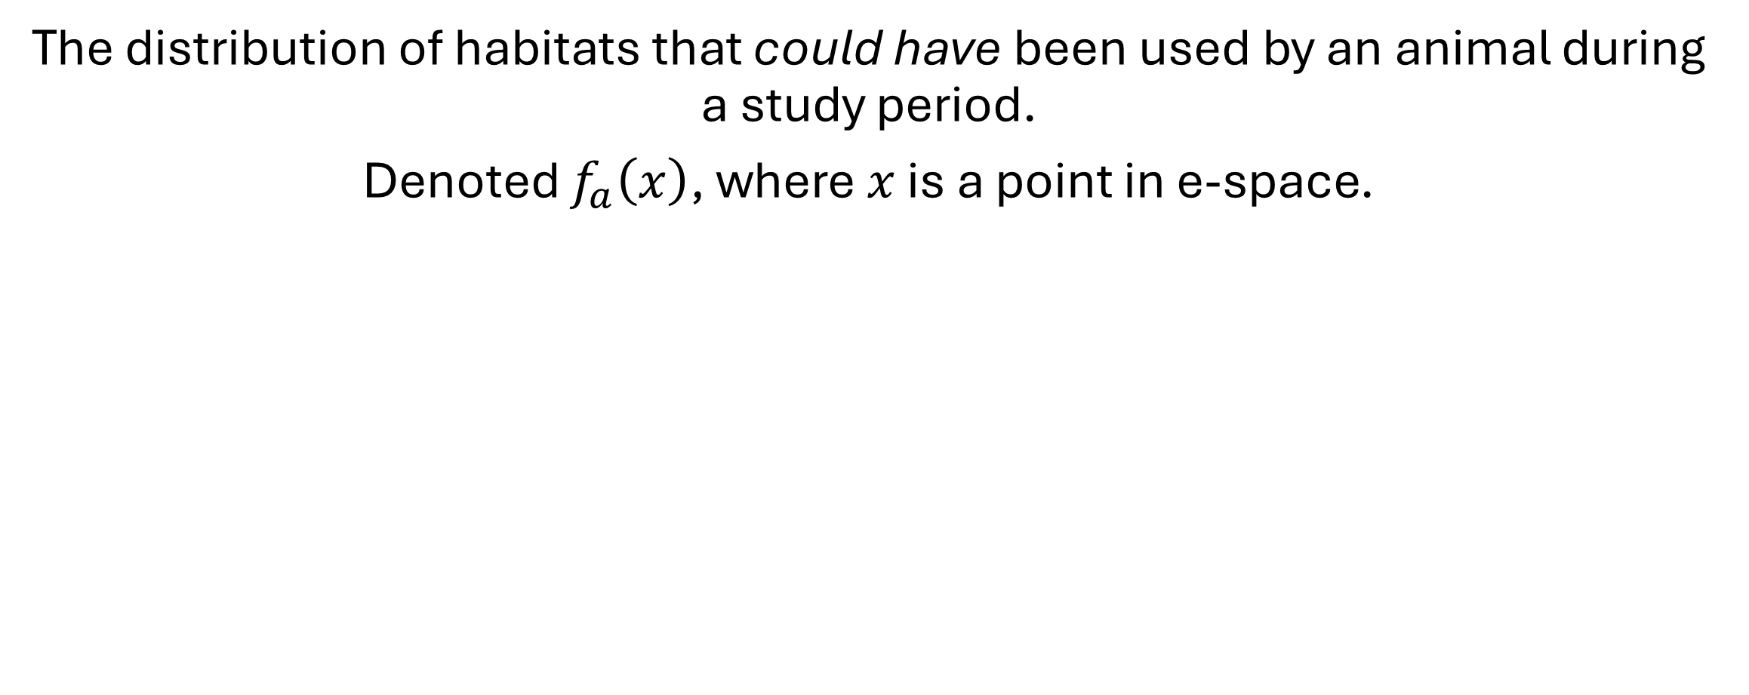
Habitat Availability
The distribution of habitats that could have been used by an animal during a study period.
Denoted $f_{a}\left(x\right)$, where $x$ is a point in e-space.
Notes:
$f_{a}\left(x\right)$ is a probability density function here
Could be a probability mass function for categorical environmental variables

Slide 20
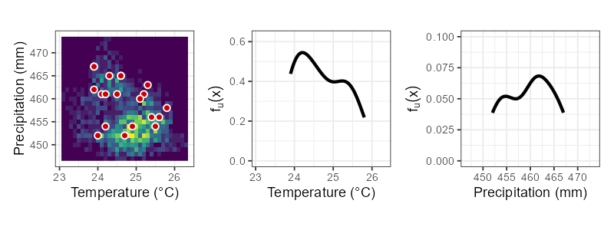
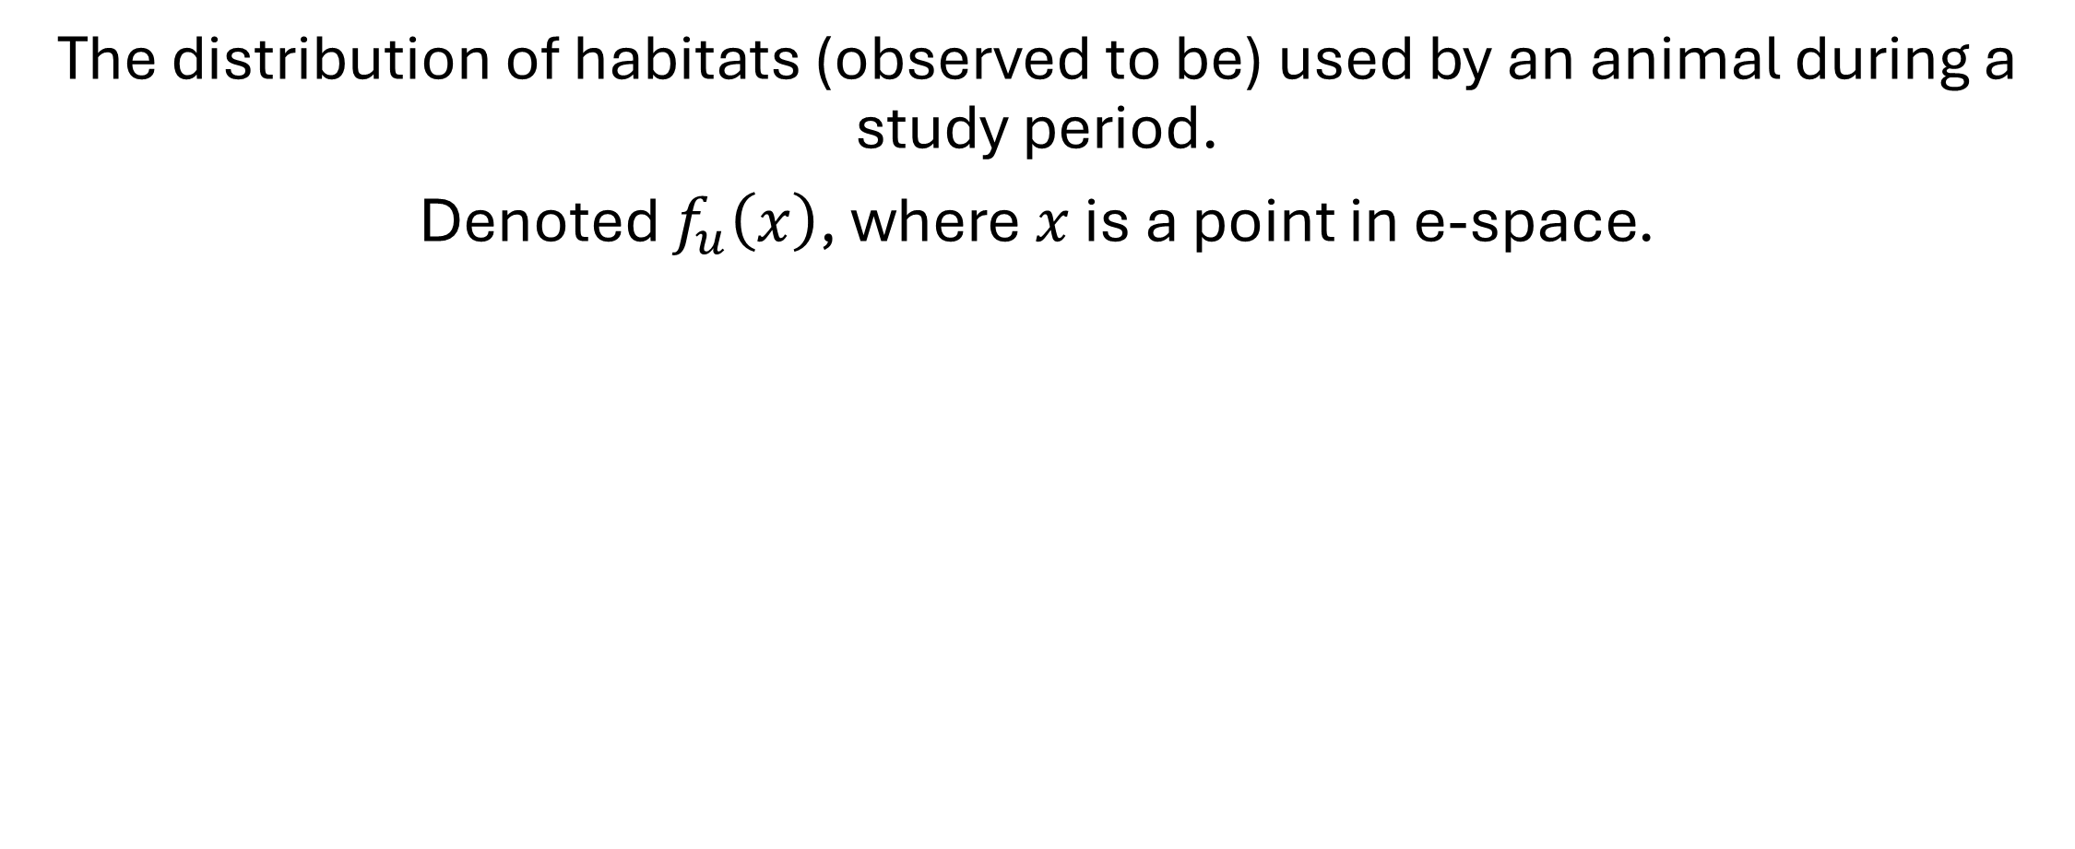
Habitat Use
The distribution of habitats (observed to be) used by an animal during a study period.
Denoted $f_{u}\left(x\right)$, where $x$ is a point in e-space.
Notes:
$f_{u}\left(x\right)$ is a probability density function
Could be a probability mass function for categorical environmental variables

Slide 21
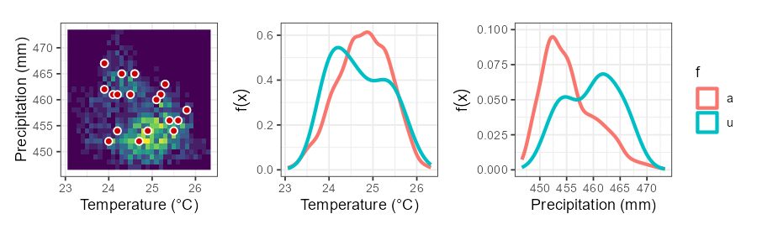
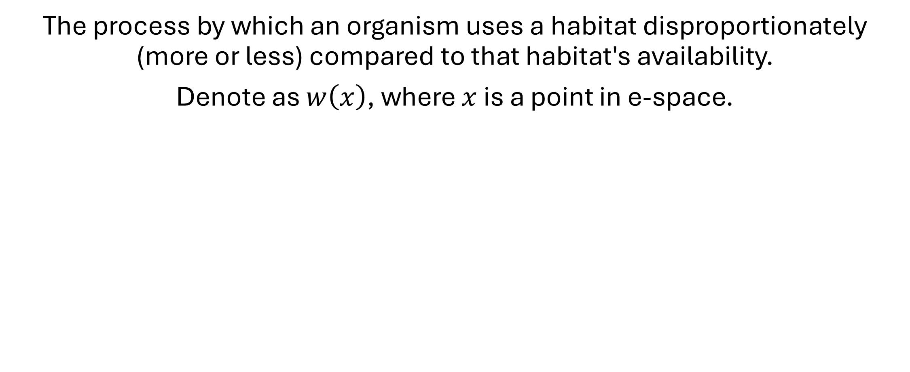
Habitat Selection
The process by which an organism uses a habitat disproportionately (more or less) compared to that habitat's availability.
Denote as $w\left(x\right)$, where $x$ is a point in e-space.
Notes:
$w\left(x\right)$ can be thought of as a weighting function that transforms $f_{a}\left(x\right)$ into $f_{u}\left(x\right)$.

Slide 22
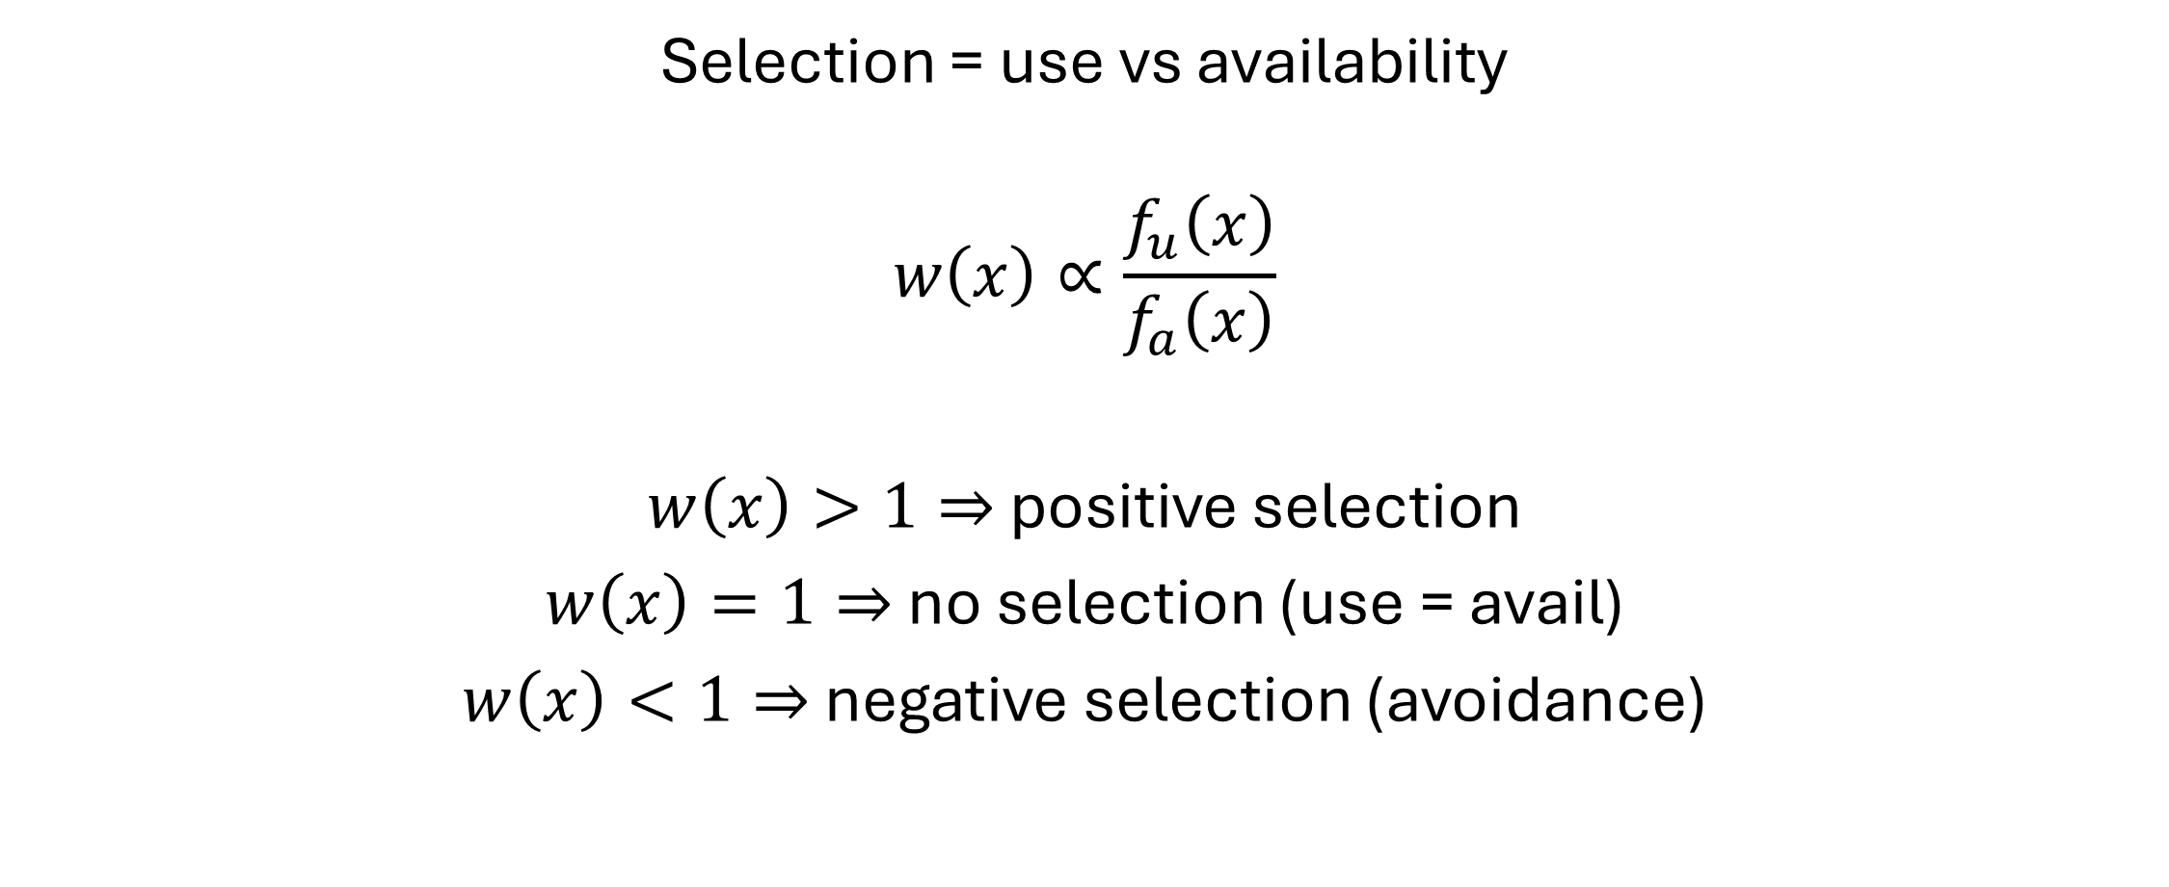
Habitat Selection
Selection = use vs availability
$$w\left(x\right)∝\frac{f_{u}\left(x\right)}{f_{a}\left(x\right)}$$
$w\left(x\right)>1⇒$ positive selection
$w\left(x\right)=1⇒$ no selection (use = avail)
$w\left(x\right)<1⇒$ negative selection (avoidance)
Notes:
(Proportional to u/a by a normalizing constant)
We assume that +/- selection indicates evolved traits that increase fitness

Slide 23
Classifying Environmental Variables
Habitat selection theory posits that habitat selection behavior evolves because of the effect of habitats on fitness (Rosenzweig 1981, 1991).
Since habitat is defined by a set of environmental variables, it is useful to categorize these variables by the effects they have on fitness.
Matthiopoulos et al. (2015) suggested classifying environmental variables into resources, risks, and conditions.
Notes:
Note that since resources are just one type of environmental variables, Matthiopoulos et al. (e.g., 2023) prefer the term HSF over RSF.

Slide 24
Classifying Environmental Variables
Resources
“Environmental variables whose density has a positive and monotonic relationship with fitness (i.e., the more, the better).”
—Matthiopoulos et al. 2015

Slide 25
Classifying Environmental Variables
Risks
“Risks are environmental variables that have a negative relationship with fitness by lowering the actual or perceived chances of individual survival or reproduction.”
—Matthiopoulos et al. 2023

Slide 26
Classifying Environmental Variables
Conditions
“Conditions are environmental variables (such as ambient temperature, humidity, salinity or pressure) that surround the organism and influence its functioning. Crucially, conditions can have both positive and negative influences on fitness.”
—Matthiopoulos et al. 2023

Slide 27
Scales of Habitat Selection
Habitat selection is use vs. availability
Use = data
Availability = (often) subjective
Our definition of availability defines the scale of our analysis

Slide 28

Scales of Habitat Selection
Notes:
Johnson (1980) defined 4 hierarchical scales of habitat selection.
This is an absolute classic.

Slide 29
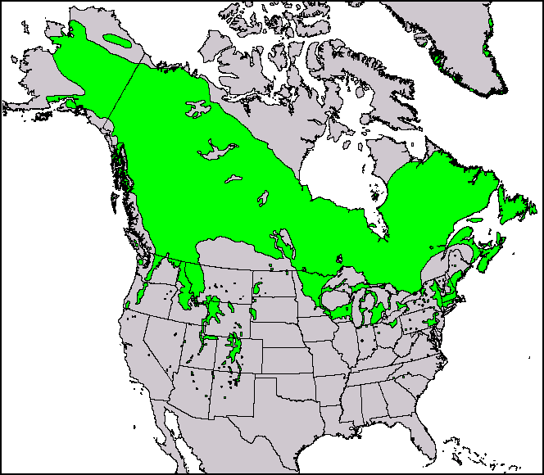
First order: species distribution
Notes:
A species distribution model (SDM) is just a first-order habitat selection model.
We will see later why these are just RSFs.

Slide 30
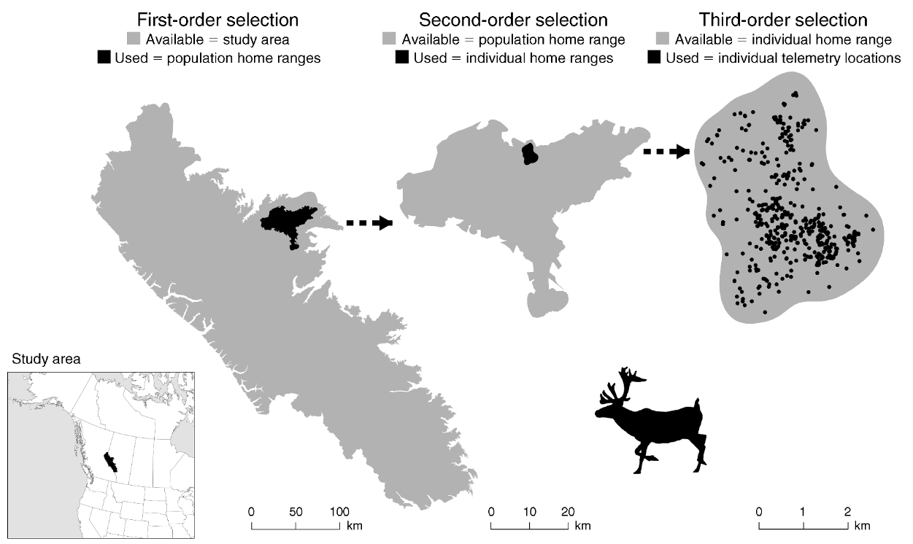
Second order: home range placement
Fig. 1 from DeCesare et al. (2012)
Notes:
Second order is where a home range is placed inside the species/geographic range

Slide 31
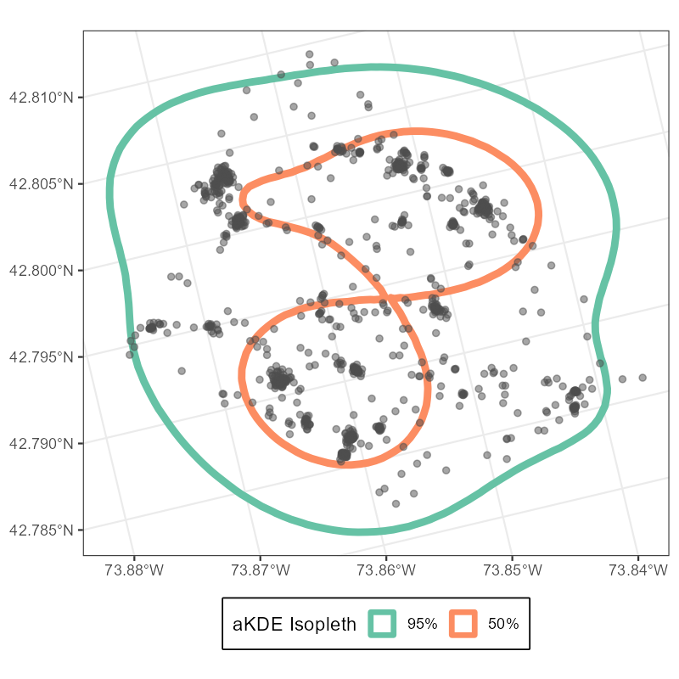
Third order: patches within home range
Notes:
Third order is particular patches within the home range

Slide 32

Fourth order: food items
Notes:
Fourth order is the specific food items being used in those patches

Slide 33

Take Home Points
Habitat is any point in e-space
Defined by any number of dimensions
Resources, risks, conditions
Habitat selection is when use is disproportionate to availability
$w\left(x\right)=f_{u}\left(x\right)/f_{a}\left(x\right)$
Scale of inference determines how you define what is available
Notes:
<9:00>

Slide 34
Habitat Selection Functions
(aka Resource Selection Functions)

Slide 35
Timeline
1995
2000
2005
2010
2015
2020
2024
Notes:
To the timeline!

Slide 36
Timeline
Manly et al. 1993
1995
2000
2005
2010
2015
2020
2024
Aebischer et al. 1993
Notes:
Aebischer et al. (1993) and Manly et al. (1993) have the same publication year.
Manly came out first, but I want to start with Aebischer, which was state-of-the-art at the time.

Slide 37

Timeline
Manly et al. 1993
1995
2000
2005
2010
2015
2020
2024
Aebischer et al. 1993
Notes:
Aebischer et al. (1993) presented compositional analysis for statistical analysis of proportions (used/available), recognizing that the categories must sum to 1.
Note the requirement for categorical habitat types. This is how habitat selection had been analyzed (but with Chi-squared tests or ANOVA) in the previous decades.

Slide 38
Simple habitat selection
Say that you've been tracking an individual animal, and this is the breakdown of the percentage of relocations you have in each habitat.
Notes:
In the spirit of compositional analysis, let’s think about a simple habitat selection example with just categorical habitats

Slide 39
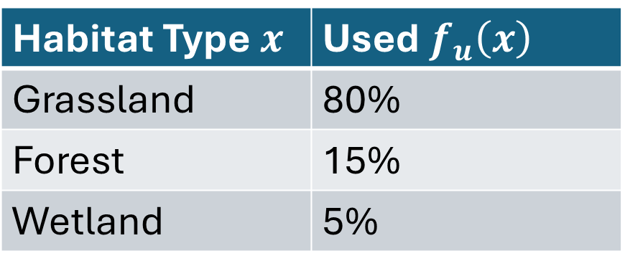
Simple habitat selection
Habitat Type $x$ | Used $f_{u}\left(x\right)$
Grassland | 80%
Forest | 15%
Wetland | 5%
Notes:
Which habitat is most important to our study animal?

Slide 40
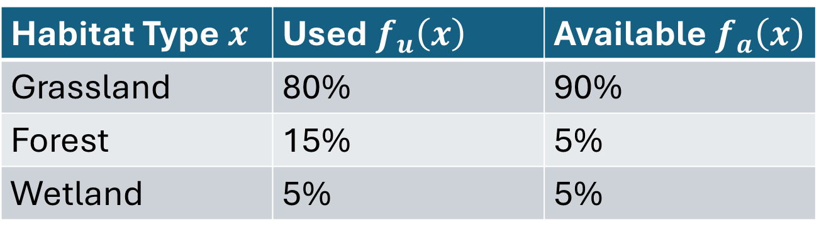
Simple habitat selection
Habitat Type $x$ | Used $f_{u}\left(x\right)$ | Available $f_{a}\left(x\right)$
Grassland | 80% | 90%
Forest | 15% | 5%
Wetland | 5% | 5%
Notes:
Now what do you think?

Slide 41
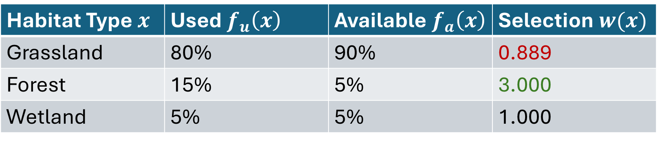

Simple habitat selection
Habitat Type $x$ | Used $f_{u}\left(x\right)$ | Available $f_{a}\left(x\right)$ | Selection $w(x)$
Grassland | 80% | 90% | 0.889
Forest | 15% | 5% | 3.000
Wetland | 5% | 5% | 1.000
$w\left(x\right)>1⇒$ positive selection
$w\left(x\right)=1⇒$ no selection (use = avail)
$w\left(x\right)<1⇒$ negative selection (avoidance)
Notes:
We can calculate the selection function by just dividing (normalizing constant = 1)

Slide 42
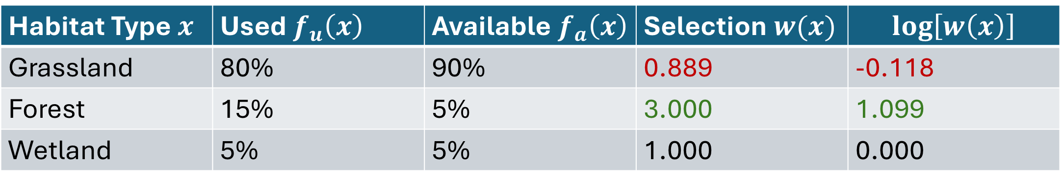

Simple habitat selection
Habitat Type $x$ | Used $f_{u}\left(x\right)$ | Available $f_{a}\left(x\right)$ | Selection $w(x)$ | $$log\left[w\left(x\right)\right]$$
Grassland | 80% | 90% | 0.889 | -0.118
Forest | 15% | 5% | 3.000 | 1.099
Wetland | 5% | 5% | 1.000 | 0.000
$\log\left[w\left(x\right)\right]>0⇒$ positive selection
$\log\left[w\left(x\right)\right]=0⇒$ no selection (use = avail)
$\log\left[w\left(x\right)\right]<0⇒$ negative selection (avoidance)
Notes:
Taking the logarithm of w(x) is useful
The method of Aebischer works with the log ratios, but only works for categorical variables

Slide 43

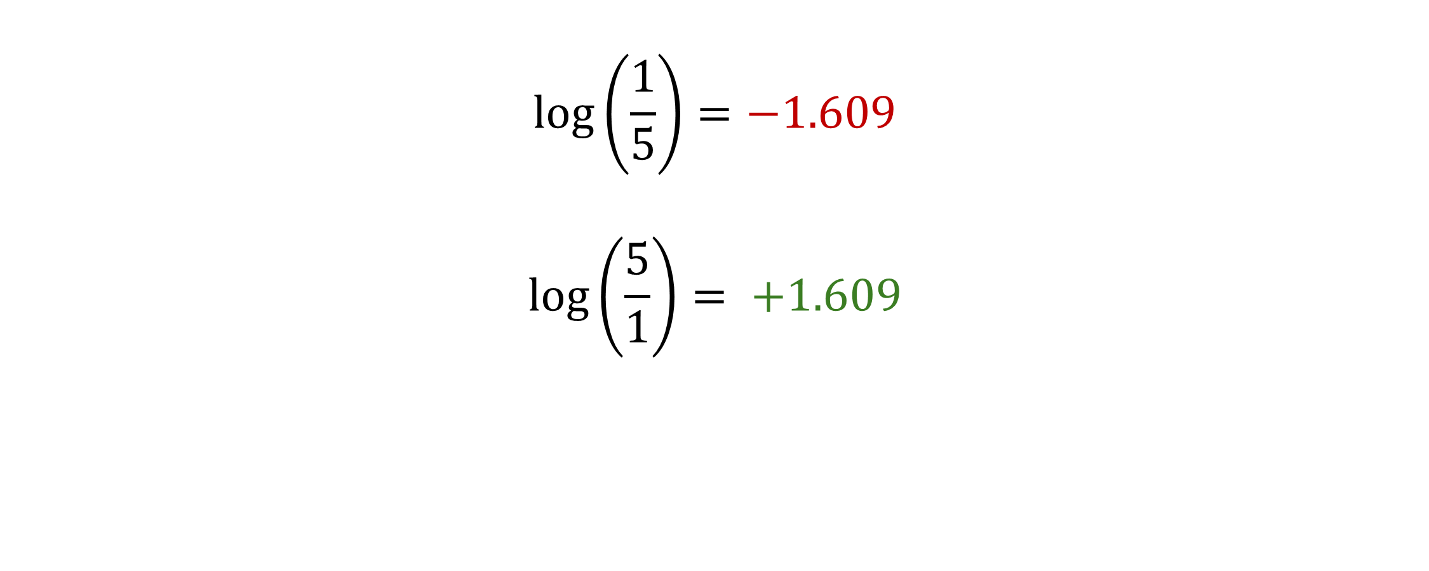
Symmetry of $log⁡()$ transforms
$$\log\left(\frac{1}{5}\right)=−1.609$$
$$\log\left(\frac{5}{1}\right)= +1.609$$
Notes:
Another useful property of logarithms is that a multiplicative inverse on the natural scale is an additive inverse on the log scale.
I.e., the strength of selection is the same in both case, but one habitat is 5x more likely to be selected and the other is 5x more likely to be avoided

Slide 44
What if we measure habitat with a continuous variable? What if we measure habitat along multiple dimensions?
Notes:
Any ideas?

Slide 45

Timeline
2002
Manly et al. 1993
1995
2000
2005
2010
2015
2020
2024
Aebischer et al. 1993
Notes:
Manly et al. published textbook, Resource Selection by Animals, in late 1992 (new edition in 2002).
This is the introduction to the term RSF.
This allowed categorical and continuous variables and introduced the form of the RSF we still use today.
Can find a PDF of this book online, btw.

Slide 46
RSFs
Resource Selection Probability Function (RSPF)
“A function that gives the probability of a resource unit being used…”
— Manly et al. (2002, p.44)
Resource Selection Function (RSF)
“A function … proportional to the probability of that unit being used.”
— Manly et al. (2002, p. ix)
Notes:
RSPFs are rarely seen in the literature.
Thanks to Jim Nichols and others (e.g., Andy Royle), we are well versed in the problem of imperfect detection and we seldom assume absences.
Models that relate habitat to true presence/absence, while controlling for imperfect detection, are typically called occupancy models, not RSPFs.

Slide 47
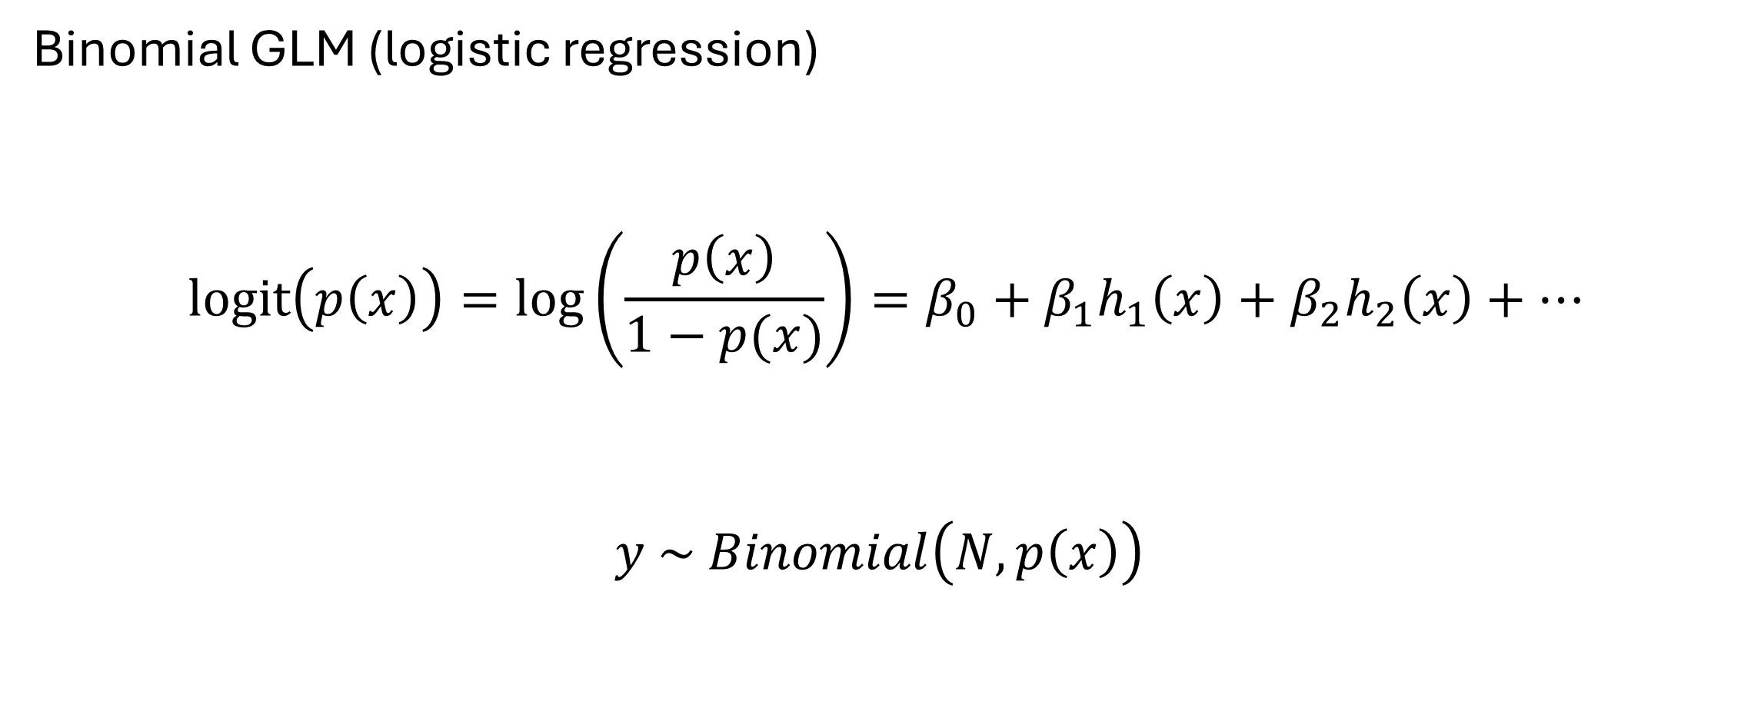
RSPFs
Binomial GLM (logistic regression)
$$logit\left(p\left(x\right)\right)=\log\left(\frac{p\left(x\right)}{1−p(x)}\right)=β_{0}+β_{1}h_{1}\left(x\right)+β_{2}h_{2}\left(x\right)+…$$
$$y \sim Binomial\left(N, p\left(x\right)\right)$$
odds ratio
change in log-odds
link function
linear predictor
random variable
distribution
parameters
Notes:
This is straightforward. Our data consists of 1s (presences) and 0s (absences). p(x) gives us the probability that x is used, it is truly a probability, and we know exactly how to interpret it.

Slide 48
What if our function is just proportional to the probability of use? (RSF)

Slide 49
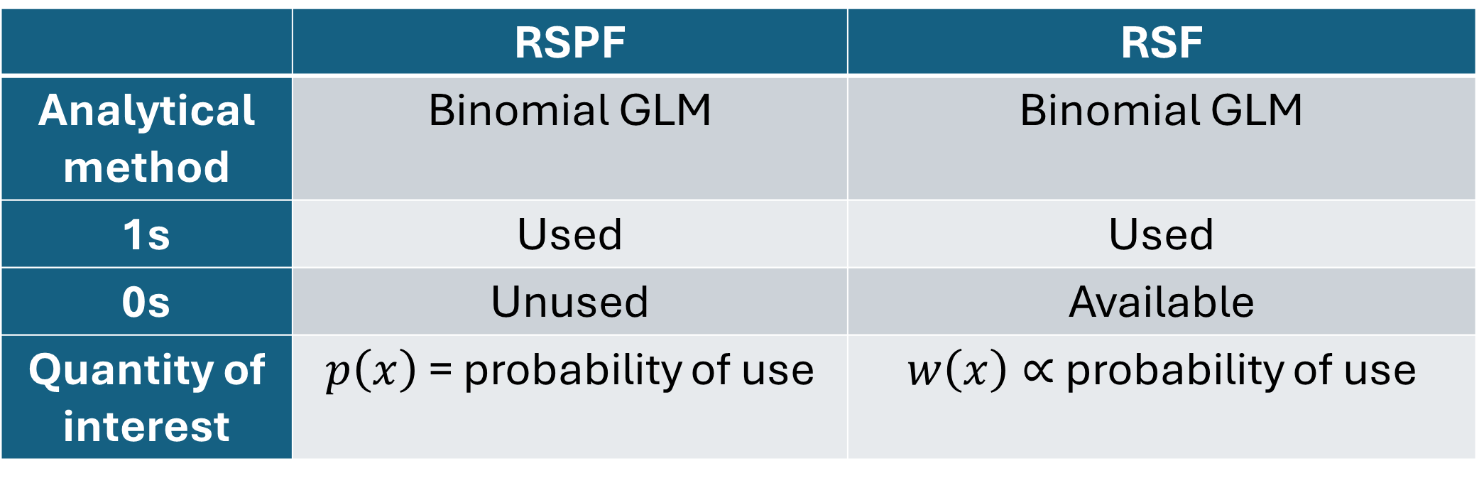
RSPFs vs. RSFs
 | RSPF | RSF
Analytical method | Binomial GLM | Binomial GLM
1s | Used | Used
0s | Unused | Available
Quantity of interest | $p\left(x\right)$ = probability of use | $w\left(x\right)∝$ probability of use
Notes:
We still use logistic regression! But this has led to a whole ton of confusion that has plagued the field to this day.

Slide 50
Timeline
Fithian & Hastie 2013
Manly et al. 1993
1995
2000
2005
2010
2015
2020
2024
Warton & Shepherd 2010
Notes:
It wasn’t until 20 years later that a few groups of statisticians told us ecologists exactly what an RSF was doing.
It turns out it’s a fitting trick for approximating a very general model, which only works under certain conditions (that we ecologists were mostly getting wrong)

Slide 51
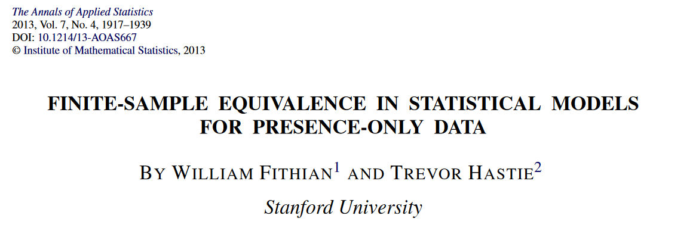
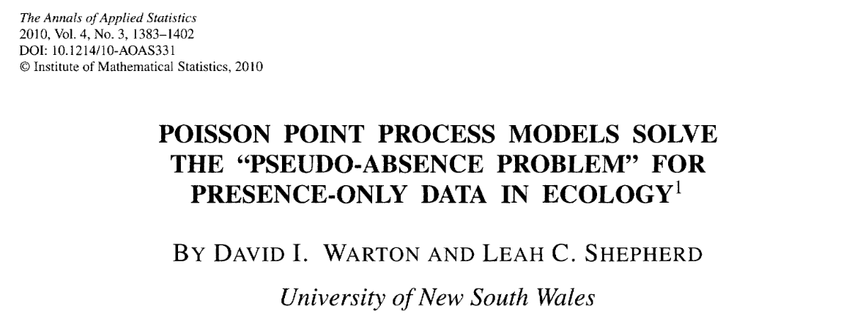
Timeline
Fithian & Hastie 2013
Manly et al. 1993
1995
2000
2005
2010
2015
2020
2024
Warton & Shepherd 2010
Notes:
Clarification came in the 2010s when statisticians pointed out that almost all the habitat selection analyses we were using were approximations to an Inhomogeneous Point Process Model.
The 20 years of RSFs (and their cousins) before this muddied the literature, led to fraught (often wrong) ad hoc methods, and much debate about things like “pseudo-absences”. Those things persist today.
These papers are dense and technical, but the main points are reviewed in Fieberg et al. (2021).

Slide 52
Inhomogeneous (Poisson) Point Process

Slide 53
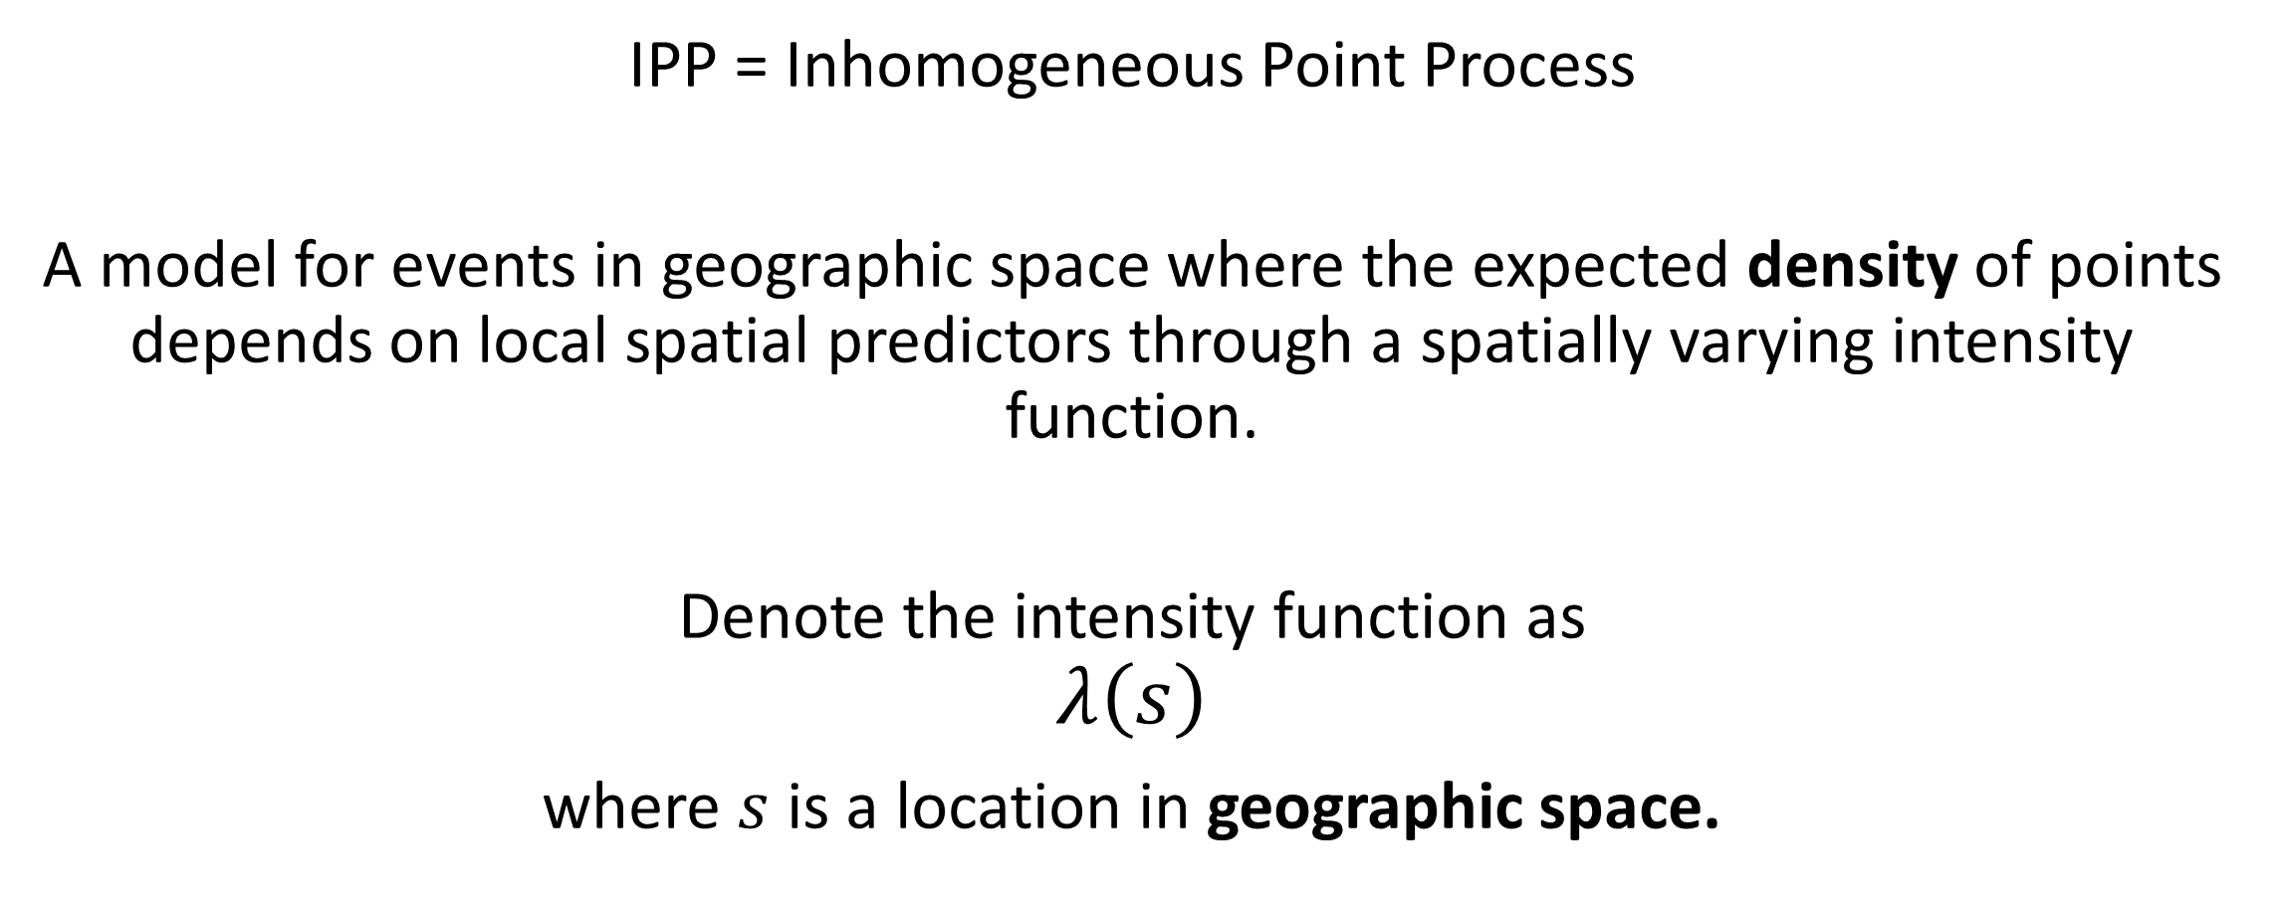
What’s an IPP?
IPP = Inhomogeneous Point Process
A model for events in geographic space where the expected density of points depends on local spatial predictors through a spatially varying intensity function.
Denote the intensity function as
$$λ\left(s\right)$$
where $s$ is a location in geographic space.

Slide 54
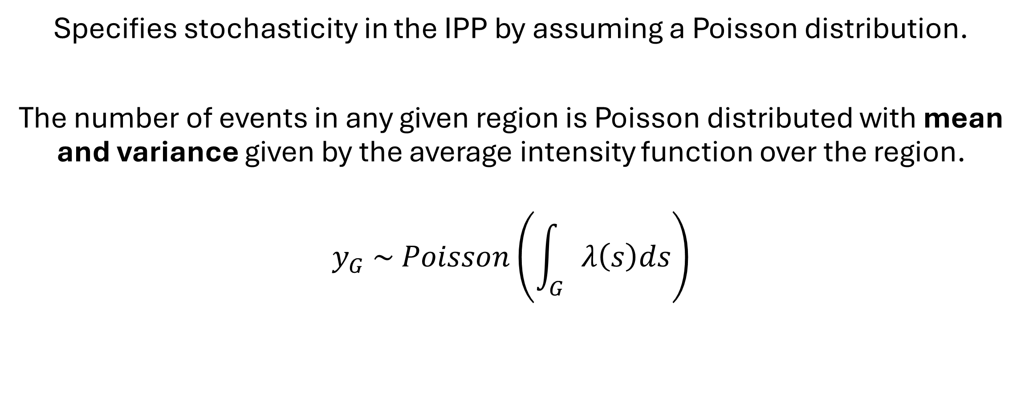
Inhomogeneous Poisson Point Process
Specifies stochasticity in the IPP by assuming a Poisson distribution.
The number of events in any given region is Poisson distributed with mean and variance given by the average intensity function over the region.
$$y_{G} \sim Poisson\left(\int_{G}{λ\left(s\right)ds}\right)$$
Notes:
An alternative, for example, would be an Inhomogeneous Negative Binomial Point Process.
Count of events in any spatial domain, G, is Poisson distributed with parameter given by the average intensity function over G

Slide 55
IPPs are everywhere!
Many common space-use models have been shown to be equivalent to the IPP (reviewed in Fieberg et al. 2021).
MaxEnt
Weighted distribution theory (with an exponential form)
Resource utilization functions (RUFs)
Resource selection functions (RSFs), a.k.a. habitat selection functions (HSFs)

Slide 56
So what?
An RSF fit using logistic regression (cf. Manly et al. 2002) is equivalent to an IPP under certain conditions.
This equivalence provides guidance on best practices.
It also provides a framework for projecting from e-space (RSF) to g-space (IPP).

Slide 57
Take Home Points
HSFs generalize habitat selection models to any number of continuous or categorical environmental axes
HSFs are one way to fit an IPP model to data
Equivalent models include MaxEnt, Weighted distribution, and RUFs
IPP provides a framework for projecting HSFs from e-space to g-space
Notes:
<~9:30 break here>

Slide 58
Fitting HSFs
Fitting IPP Models to Telemetry Data

Slide 59
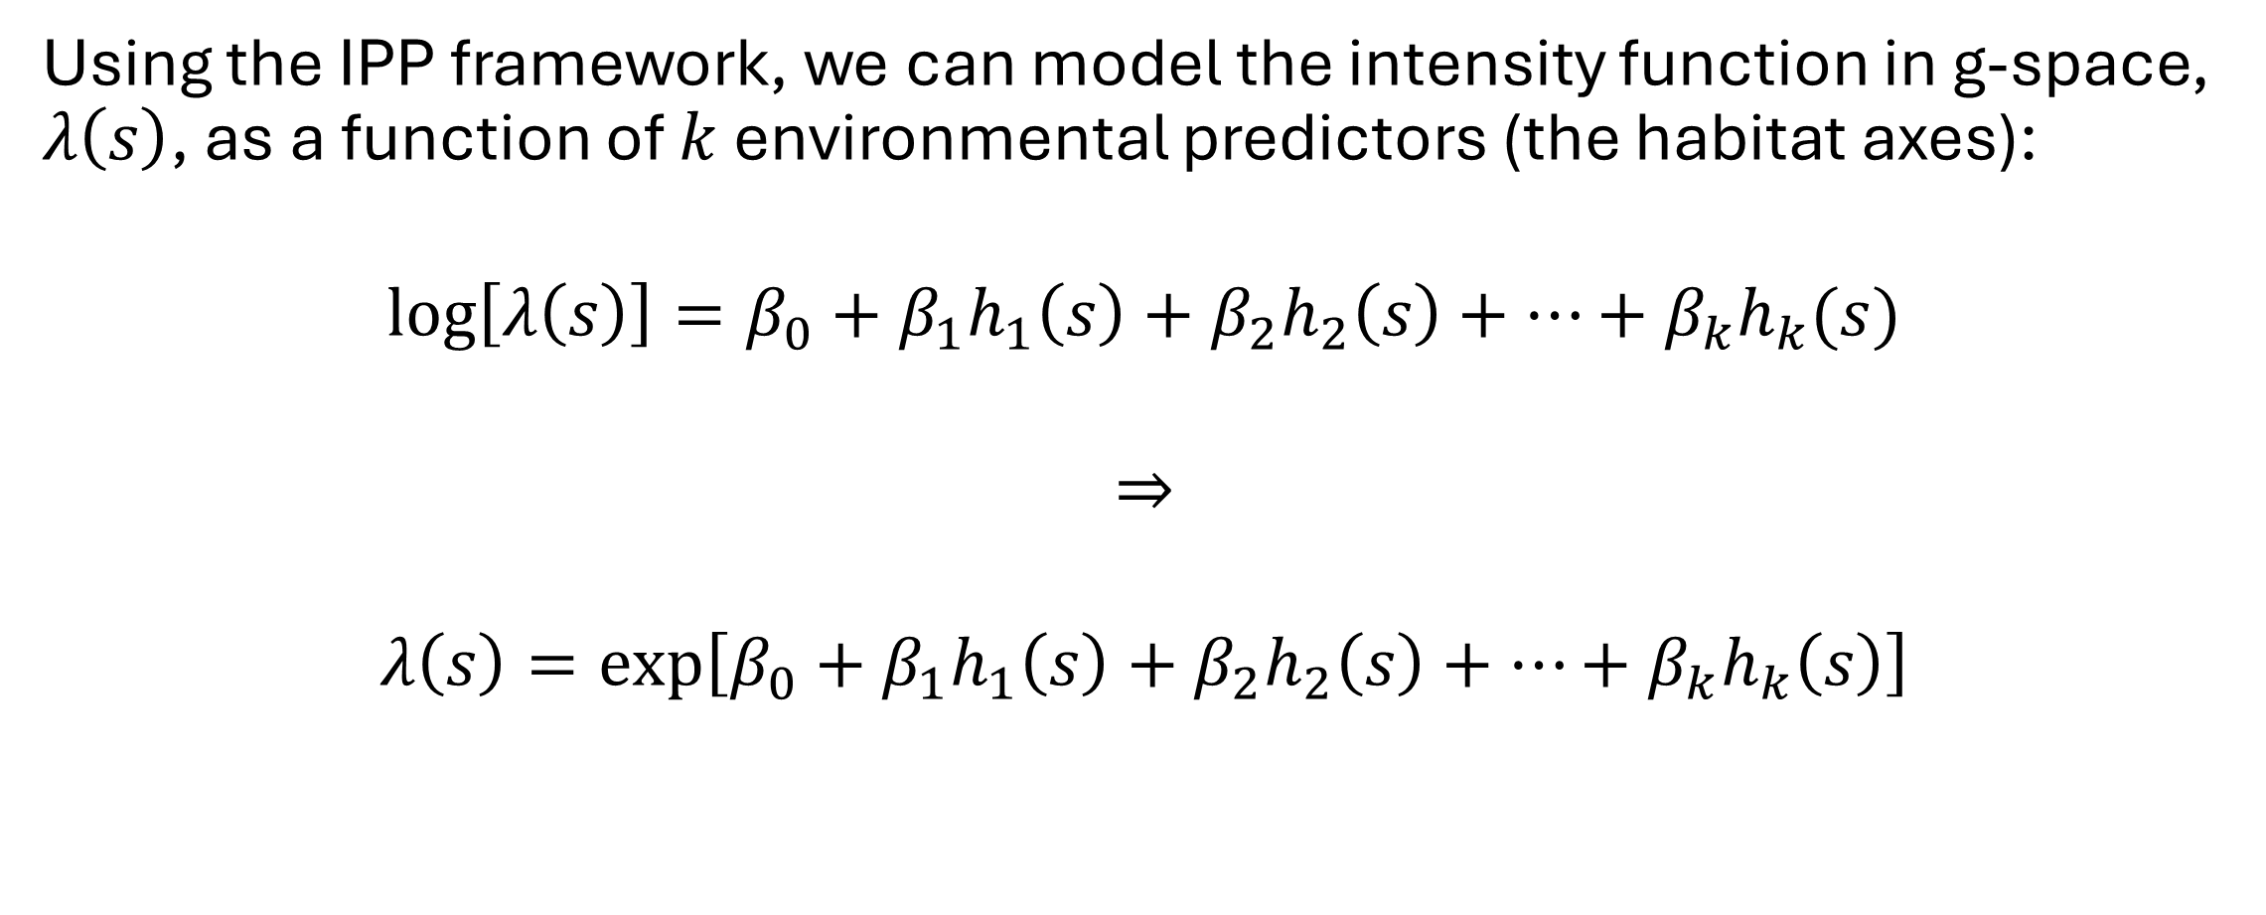
HSFs
Using the IPP framework, we can model the intensity function in g-space, $λ\left(s\right)$, as a function of $k$ environmental predictors (the habitat axes):
$$\log\left[λ\left(s\right)\right]=β_{0}+β_{1}h_{1}\left(s\right)+β_{2}h_{2}\left(s\right)+…+β_{k}h_{k}(s)$$
$$⇒$$
$$λ\left(s\right)=\exp\left[β_{0}+β_{1}h_{1}\left(s\right)+β_{2}h_{2}\left(s\right)+…+β_{k}h_{k}\left(s\right)\right]$$
Notes:
Note that lambda(s) is an exponential function of covariates
This is the same form as the expected value of a Poisson regression

Slide 60
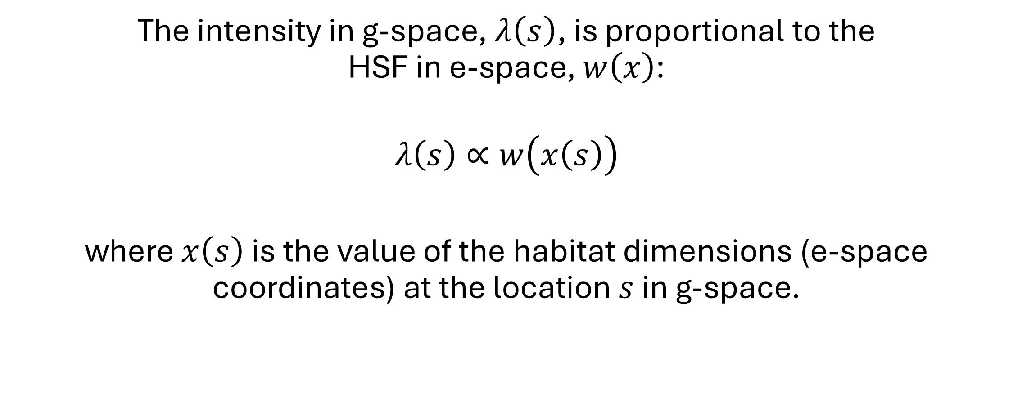
HSFs
The intensity in g-space, $λ\left(s\right)$, is proportional to the HSF in e-space, $w\left(x\right)$:
$$λ\left(s\right)∝w\left(x\left(s\right)\right)$$
where $x\left(s\right)$ is the value of the habitat dimensions (e-space coordinates) at the location $s$ in g-space.
Notes:
This matches Manly et al.’s (2002) definition of an RSF as any function proportional to the probability of use, but I’m not going to explain that in detail here.

Slide 61
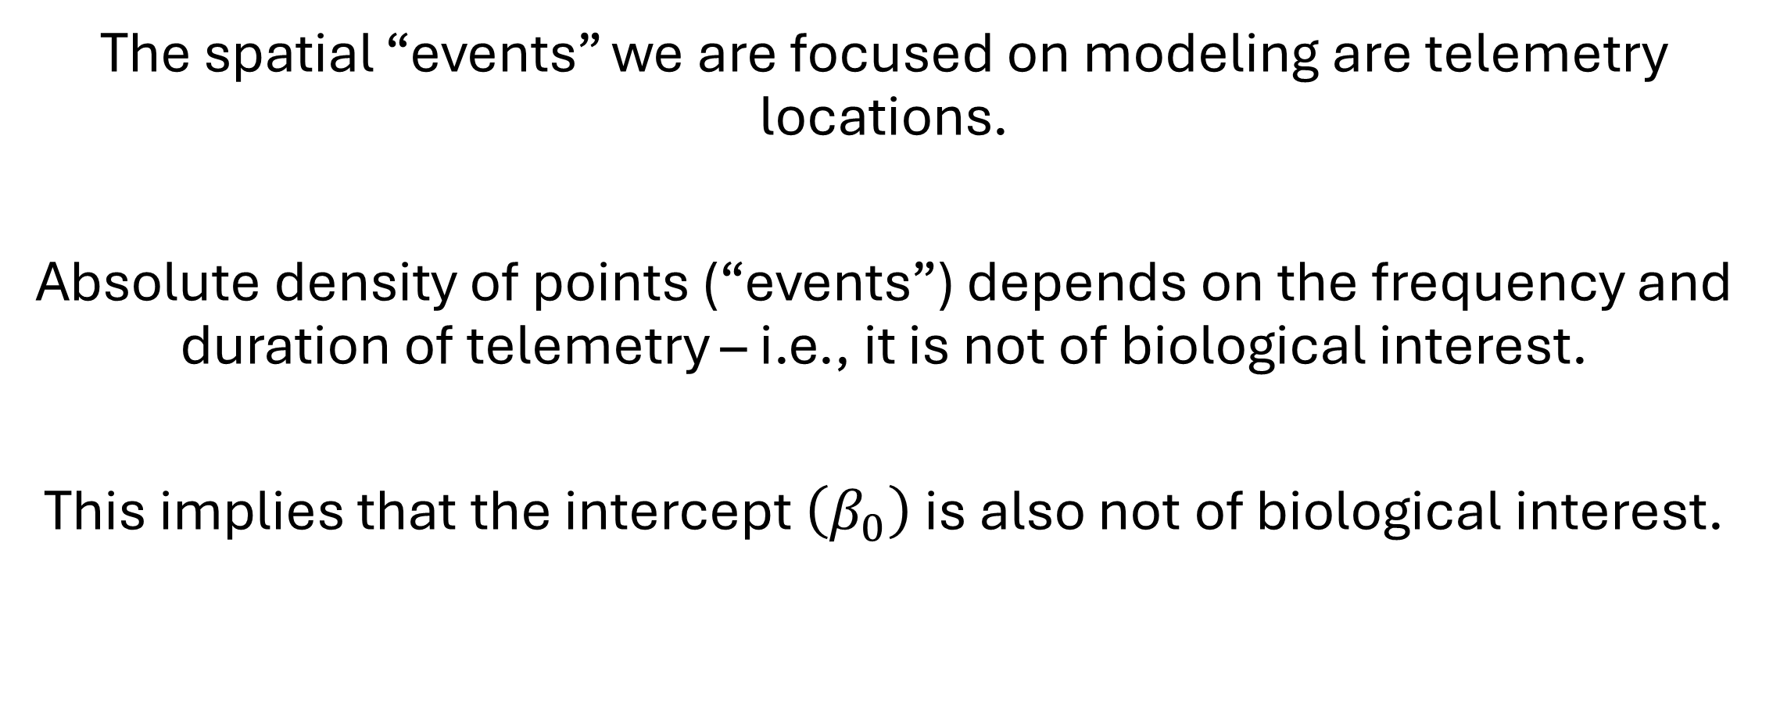
HSFs
The spatial “events” we are focused on modeling are telemetry locations.
Absolute density of points (“events”) depends on the frequency and duration of telemetry – i.e., it is not of biological interest.
This implies that the intercept $\left(β_{0}\right)$ is also not of biological interest.
Notes:
If we monitor an animal for 1-year with a fix every 24-h, we get 365 locations.
If we monitor an animal for 1-year with a fix every 1-h, we get 8,760 locations.
The slopes (how selection changes with habitat) will be the same, but the intercept is what changes.

Slide 62
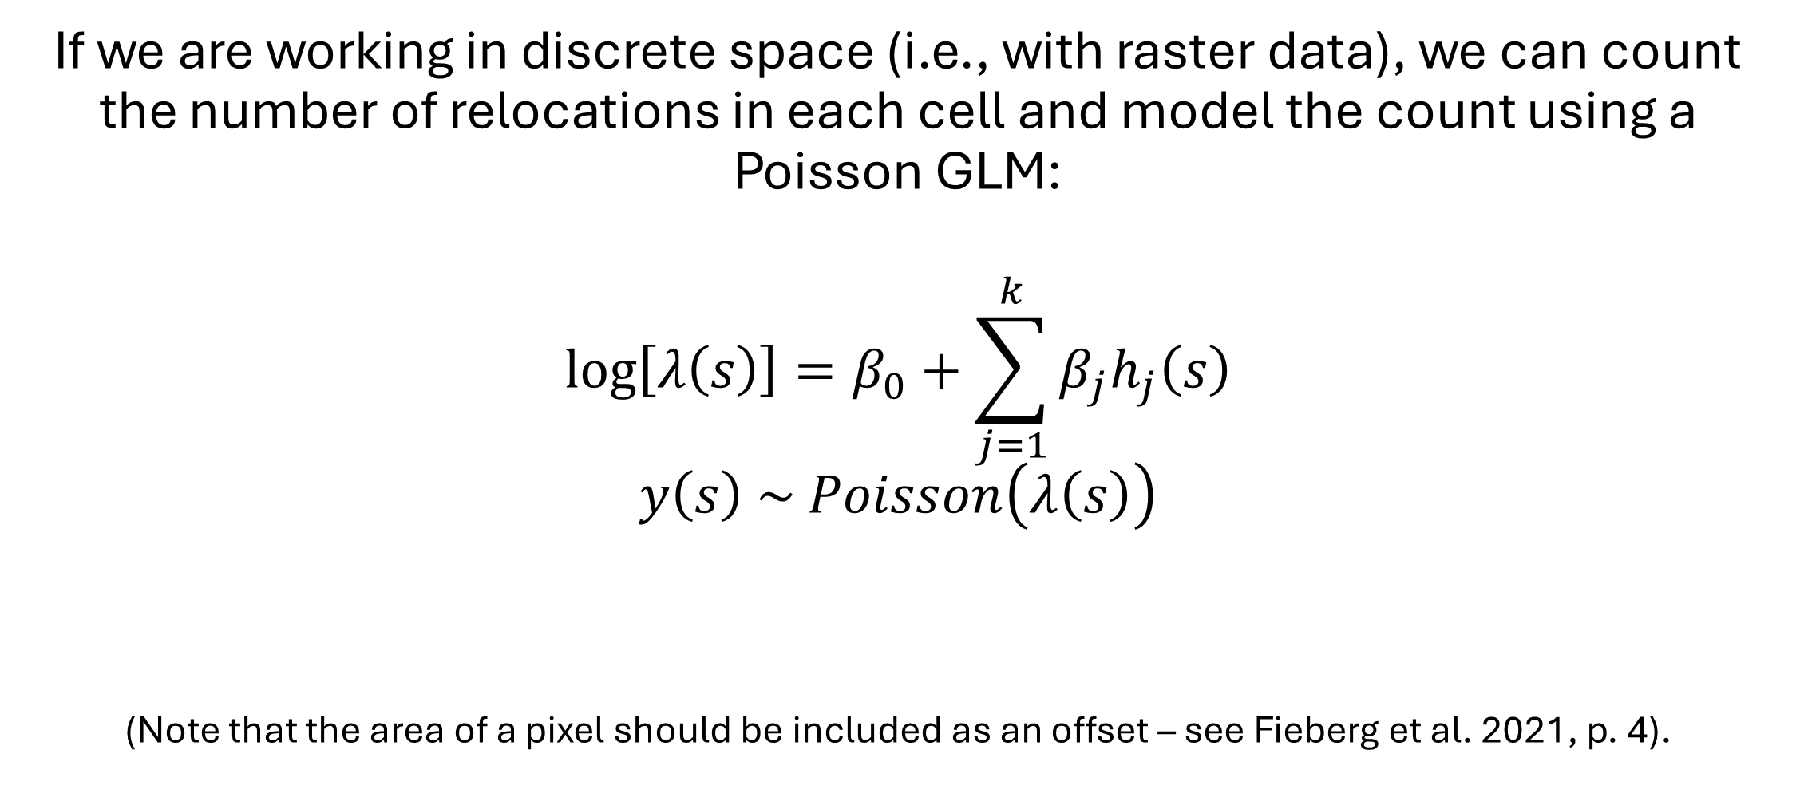
How do we fit an HSF?
If we are working in discrete space (i.e., with raster data), we can count the number of relocations in each cell and model the count using a Poisson GLM:
$$\log\left[λ\left(s\right)\right]=β_{0}+\sum_{j=1}^{k}{β_{j}h_{j}\left(s\right)}$$
$$y\left(s\right) \sim Poisson\left(λ\left(s\right)\right)$$
(Note that the area of a pixel should be included as an offset – see Fieberg et al. 2021, p. 4).

Slide 63
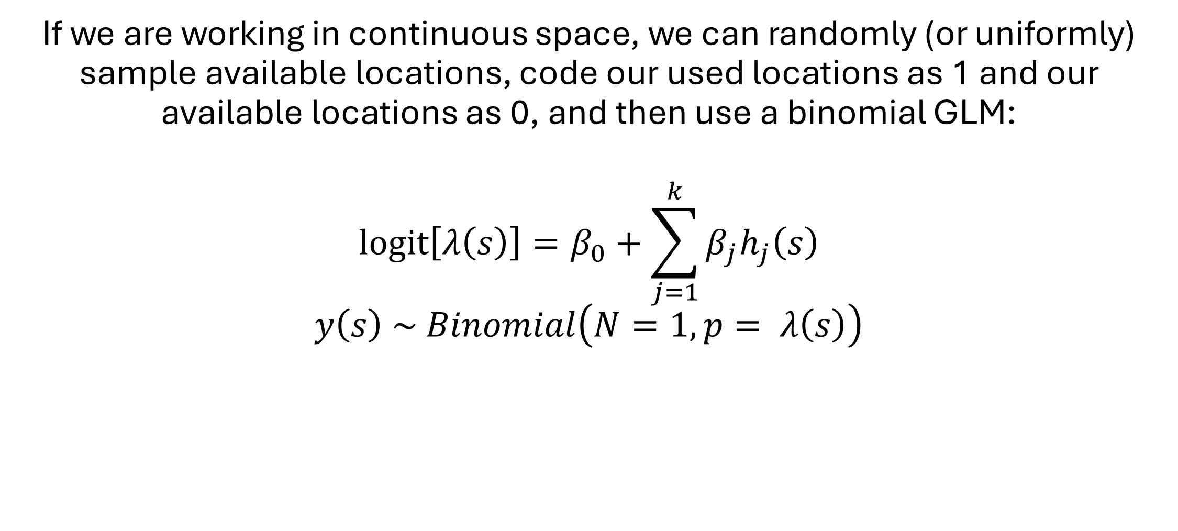
How do we fit an HSF?
If we are working in continuous space, we can randomly (or uniformly) sample available locations, code our used locations as 1 and our available locations as 0, and then use a binomial GLM:
$$\operatorname{logit}\left[λ\left(s\right)\right]=β_{0}+\sum_{j=1}^{k}{β_{j}h_{j}\left(s\right)}$$
$$y\left(s\right) \sim Binomial\left(N=1, p= λ\left(s\right)\right)$$
Notes:
Working in continuous space is useful if our covariates are not all at the same resolution or if they involve vector rather than raster data.
This is the most common approach for fitting HSFs

Slide 64
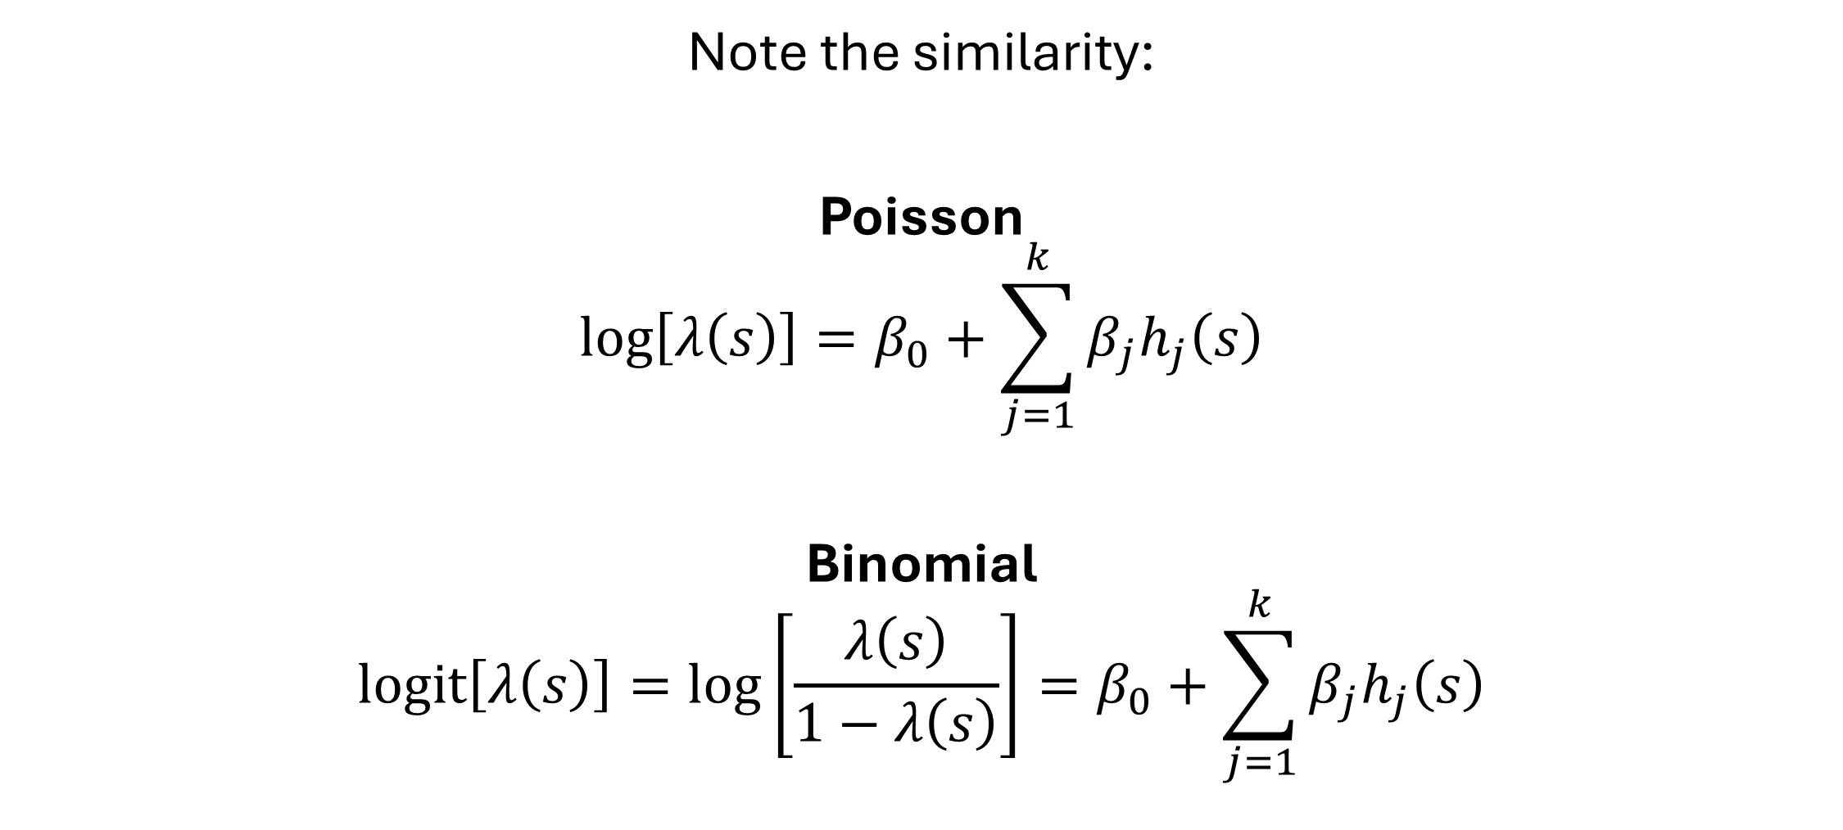
How do we fit an HSF?
Note the similarity:
Poisson
$$\log\left[λ\left(s\right)\right]=β_{0}+\sum_{j=1}^{k}{β_{j}h_{j}\left(s\right)}$$
Binomial
$$\operatorname{logit}\left[λ\left(s\right)\right]=\log\left[\frac{λ\left(s\right)}{1−λ\left(s\right)}\right]=β_{0}+\sum_{j=1}^{k}{β_{j}h_{j}\left(s\right)}$$
Notes:
The only difference is the denominator of the binomial.

Slide 65
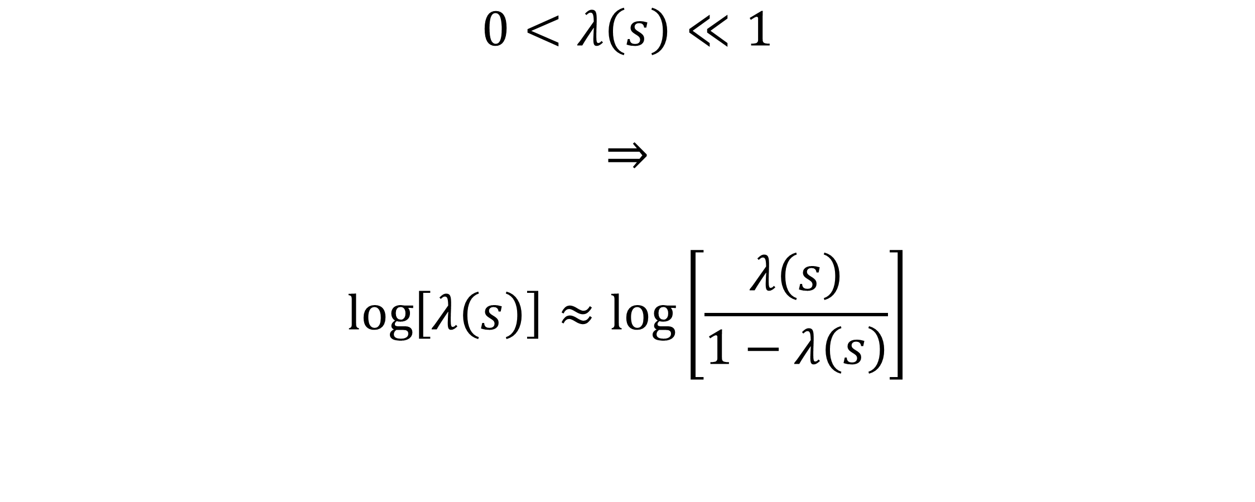
How do we fit an HSF?
$$0<λ\left(s\right)≪1$$
$$⇒$$
$$\log\left[λ\left(s\right)\right]≈\log\left[\frac{λ\left(s\right)}{1−λ\left(s\right)}\right]$$
Notes:
As lambda(s) becomes really small, that denominator approaches 1.

Slide 66
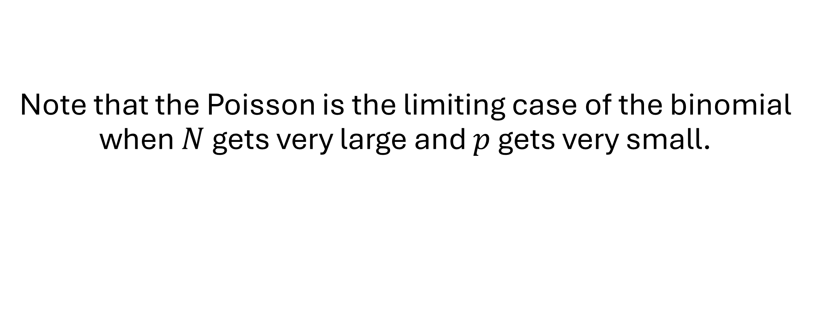
How do we fit an HSF?
Note that the Poisson is the limiting case of the binomial when $N$ gets very large and $p$ gets very small.

Slide 67
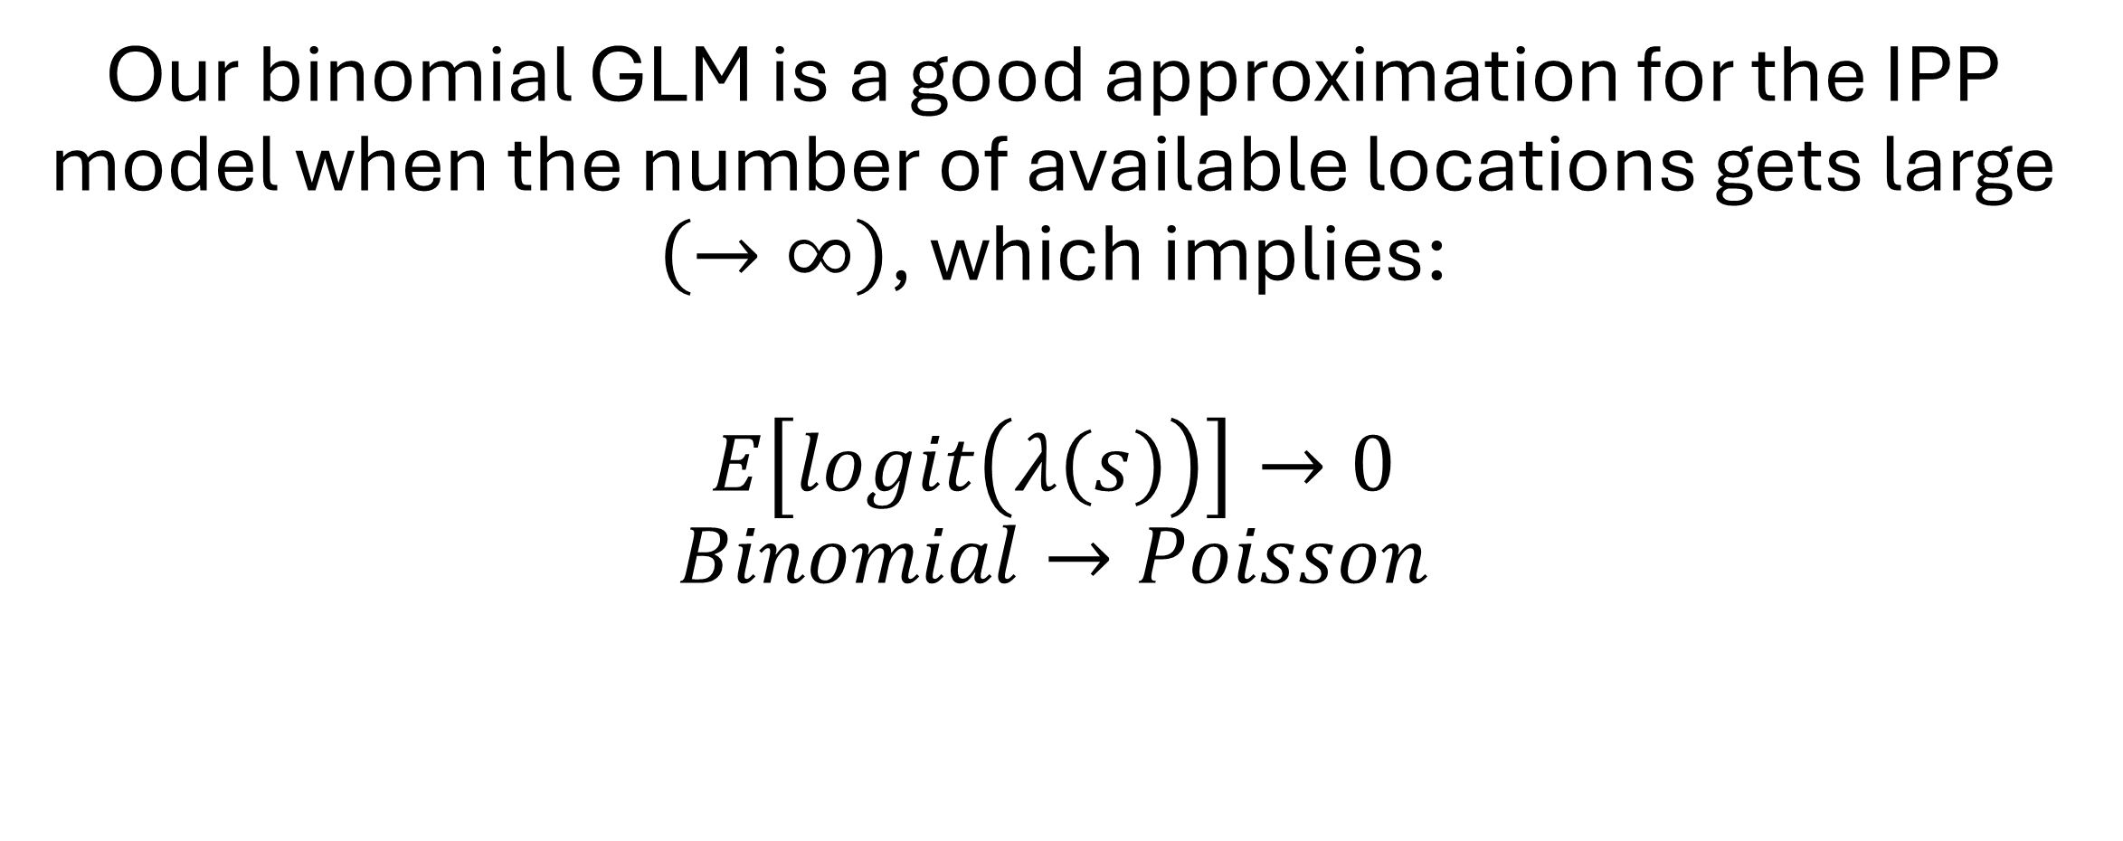
So what?
Our binomial GLM is a good approximation for the IPP model when the number of available locations gets large $\left(→∞\right)$, which implies:
$$E\left[logit\left(λ\left(s\right)\right)\right]→0$$
$$Binomial→Poisson$$

Slide 68
So what?
We already mentioned that the intercept of the IPP from telemetry data is not of biological interest.
The intercept of the logistic regression is related to the ratio of 0s and 1s and so is furthermore not the intercept of the IPP.
However, the other β parameters converge to the slopes of the IPP model as the number of available points tends to infinity (Warton and Shepherd 2010).
Further, assigning "infinite weights" to available points ensures this equivalence with the IPP (Fithian and Hastie 2013).

Slide 69
Take-home Points
We can fit an HSF using Poisson regression (discrete space) or logistic regression (continuous space).
The equivalence to an IPP only holds as the number of available points becomes large (and receive “infinite” weight).
The intercept is not of interest, so ignore it.
The slopes measure habitat selection

Slide 70
Relative Selection Strength
Effect Sizes from Habitat Selection Models

Slide 71
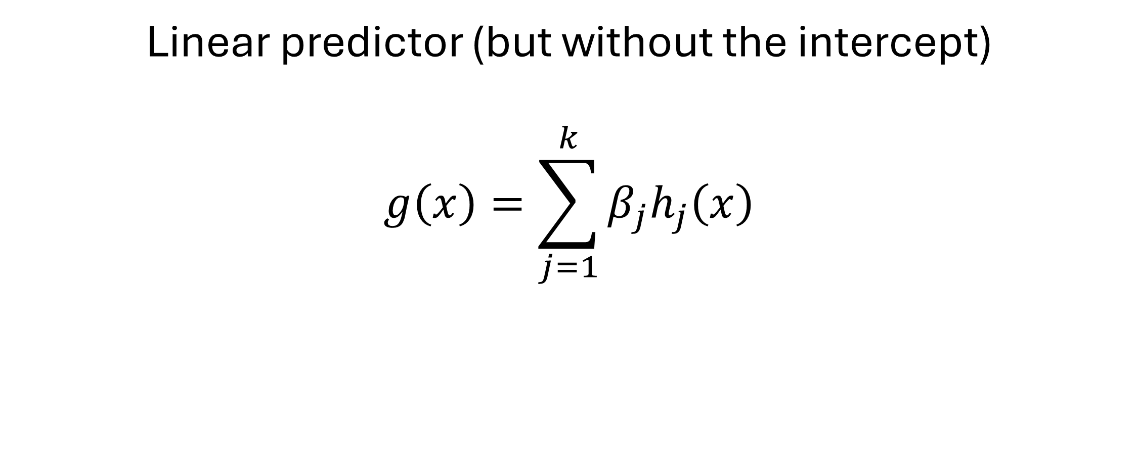
How do we interpret our fitted HSF?
Linear predictor (but without the intercept)
$$g\left(x\right)=\sum_{j=1}^{k}{β_{j}h_{j}\left(x\right)}$$
Notes:
I will stick to the g(x) notation throughout

Slide 72
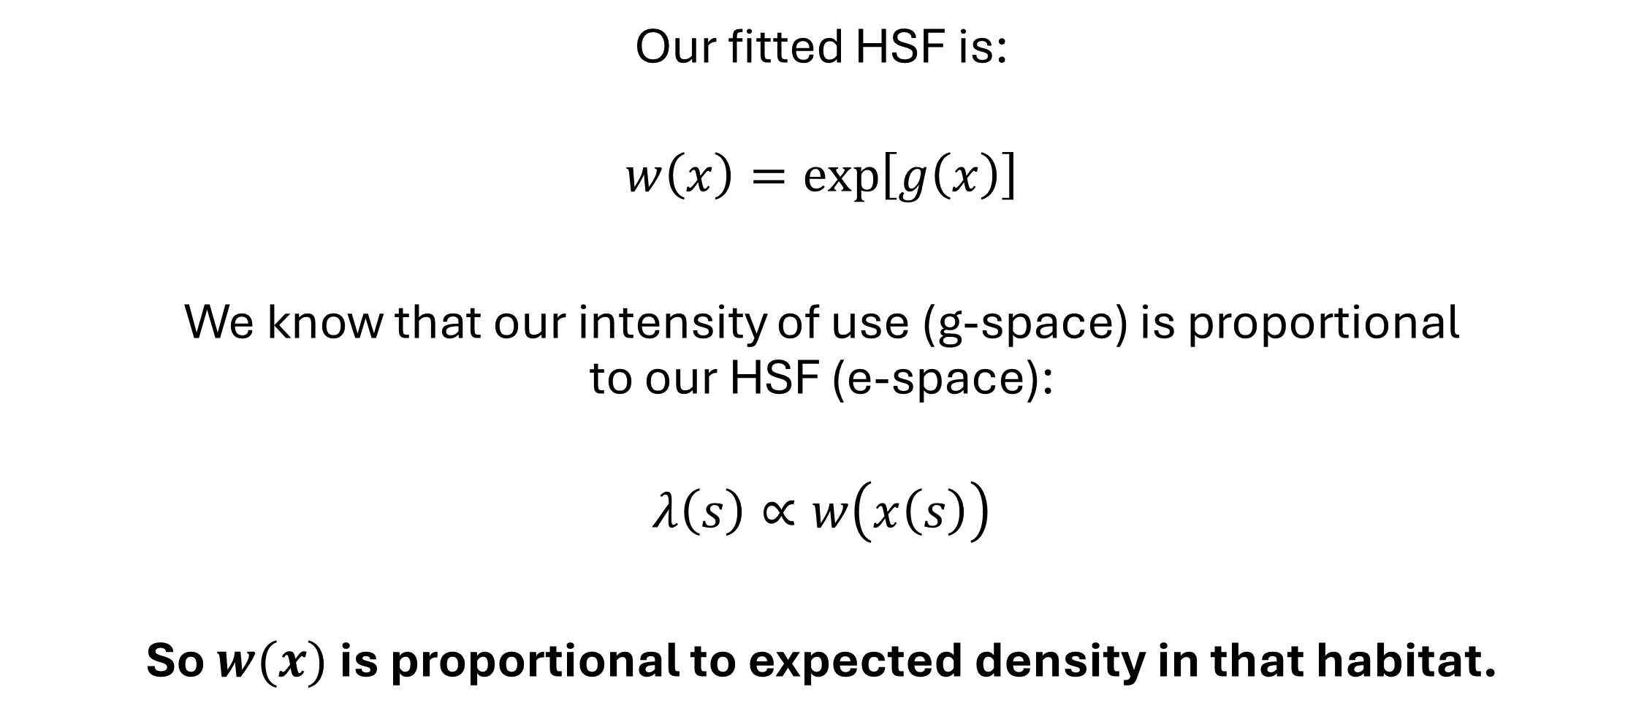
How do we interpret our fitted HSF?
Our fitted HSF is:
$$w\left(x\right)=\exp\left[g\left(x\right)\right]$$
We know that our intensity of use (g-space) is proportional to our HSF (e-space):
$$λ\left(s\right)∝w\left(x\left(s\right)\right)$$
So $w(x)$ is proportional to expected density in that habitat.

Slide 73
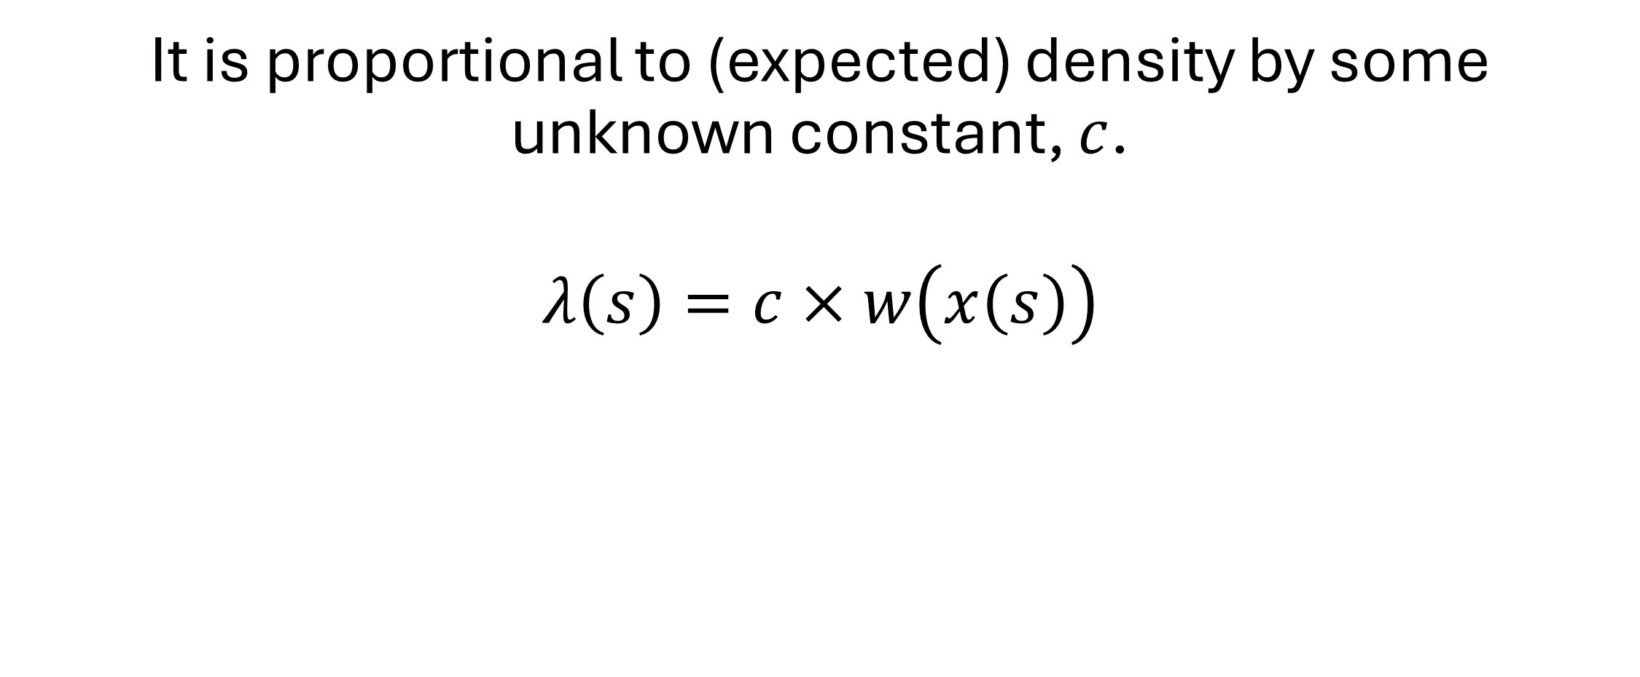
How do we interpret our fitted HSF?
It is proportional to (expected) density by some unknown constant, $c$.
$$λ\left(s\right)=c×w\left(x\left(s\right)\right)$$

Slide 74
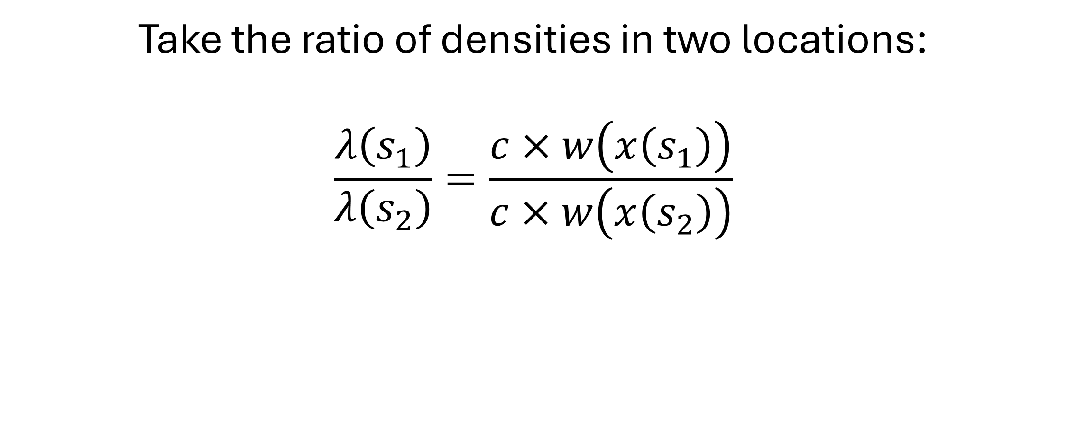
How do we interpret our fitted HSF?
Take the ratio of densities in two locations:
$$\frac{λ\left(s_{1}\right)}{λ\left(s_{2}\right)}=\frac{c×w\left(x\left(s_{1}\right)\right)}{c×w\left(x\left(s_{2}\right)\right)}$$
Notes:
So the ratio of the HSF in two locations is the same as the ratio of the density of points in the two locations

Slide 75
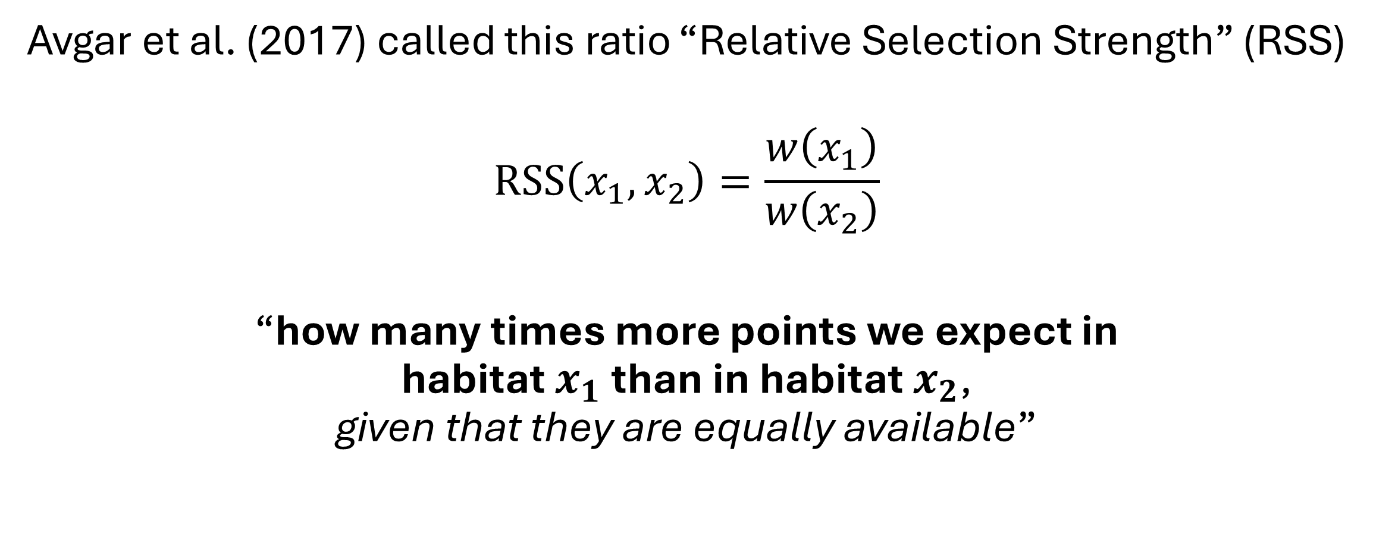
Relative Selection Strength (RSS)
Avgar et al. (2017) called this ratio “Relative Selection Strength” (RSS)
$$RSS\left(x_{1}, x_{2}\right)=\frac{w\left(x_{1}\right)}{w\left(x_{2}\right)}$$
“how many times more points we expect in habitat $x_{1}$ than in habitat $x_{2}$, given that they are equally available”
Notes:
Remember, “points” are generally telemetry locations.

Slide 76
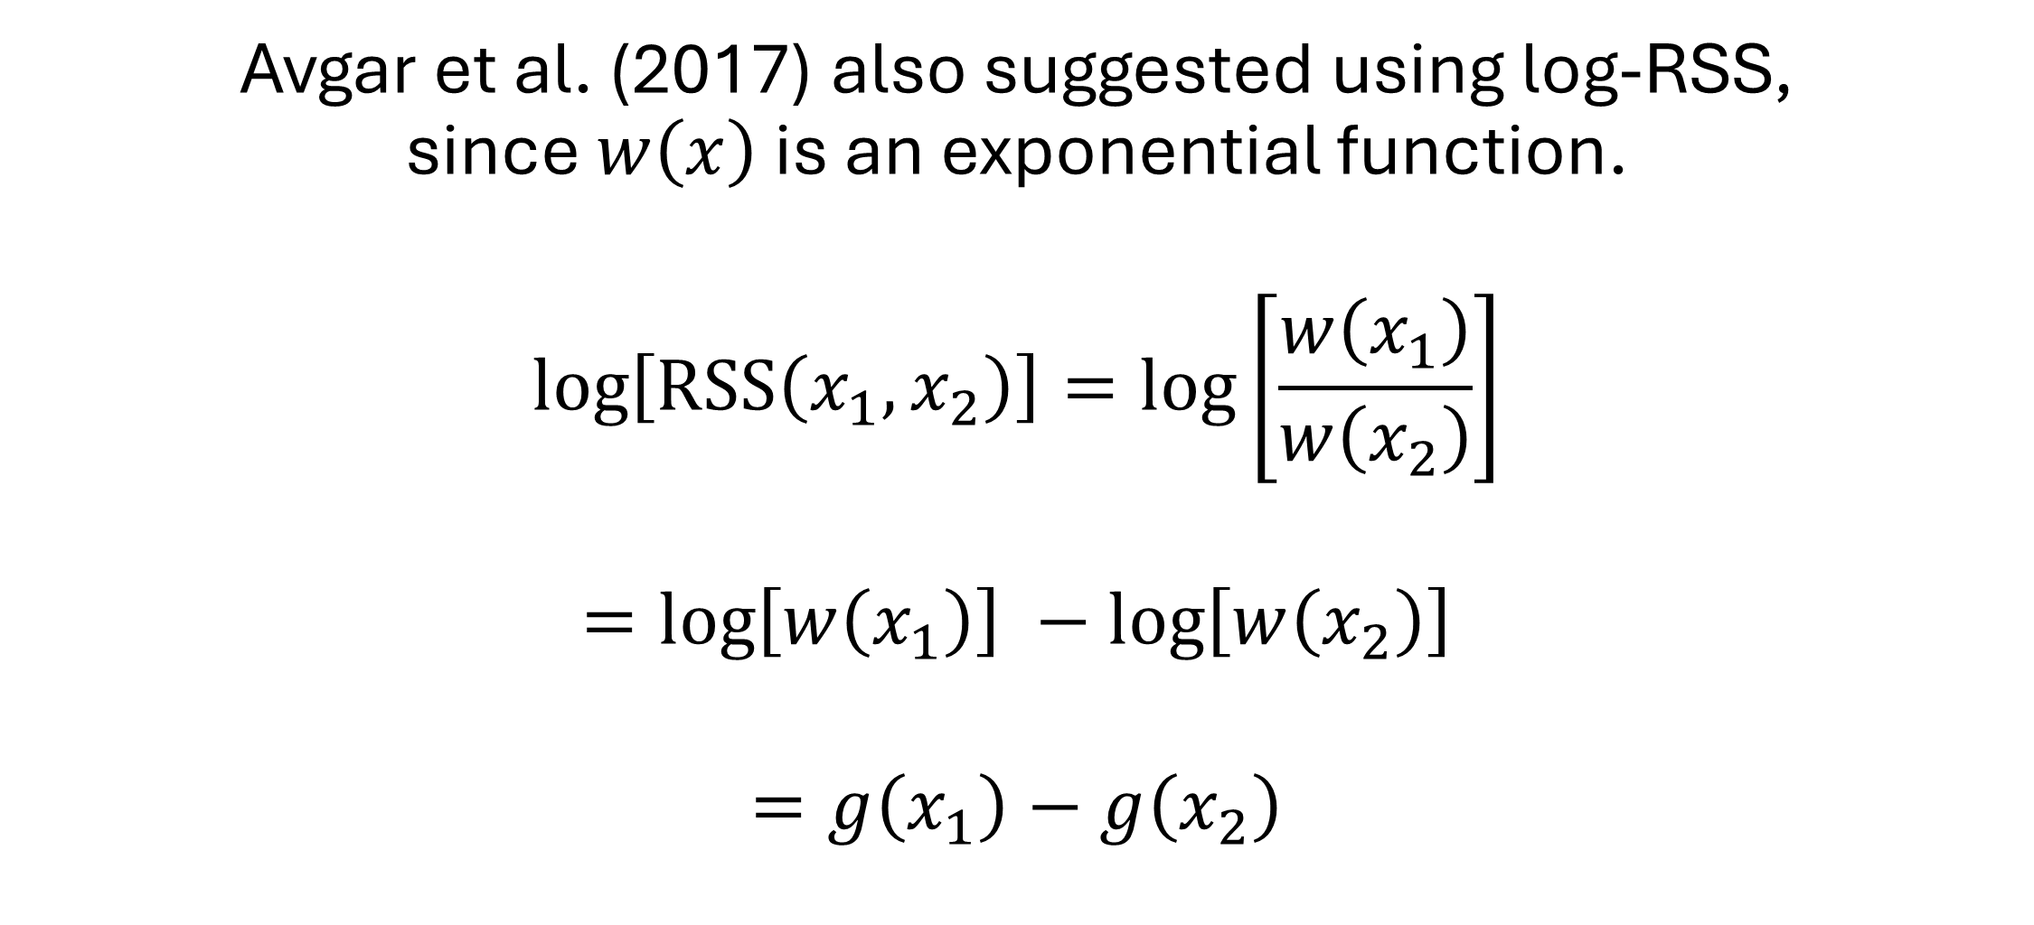
log-RSS
Avgar et al. (2017) also suggested using log-RSS, since $w\left(x\right)$ is an exponential function.
$$\log\left[RSS\left(x_{1},x_{2}\right)\right]=\log\left[\frac{w\left(x_{1}\right)}{w\left(x_{2}\right)}\right]$$
$$=\log\left[w\left(x_{1}\right)\right] −\log\left[w\left(x_{2}\right)\right]$$
$$=g\left(x_{1}\right)−g\left(x_{2}\right)$$
Notes:
So log-RSS is just the difference in the linear predictors for the two habitats. log-RSS is easier to calculate than RSS, but RSS has a more intuitive interpretation

Slide 77
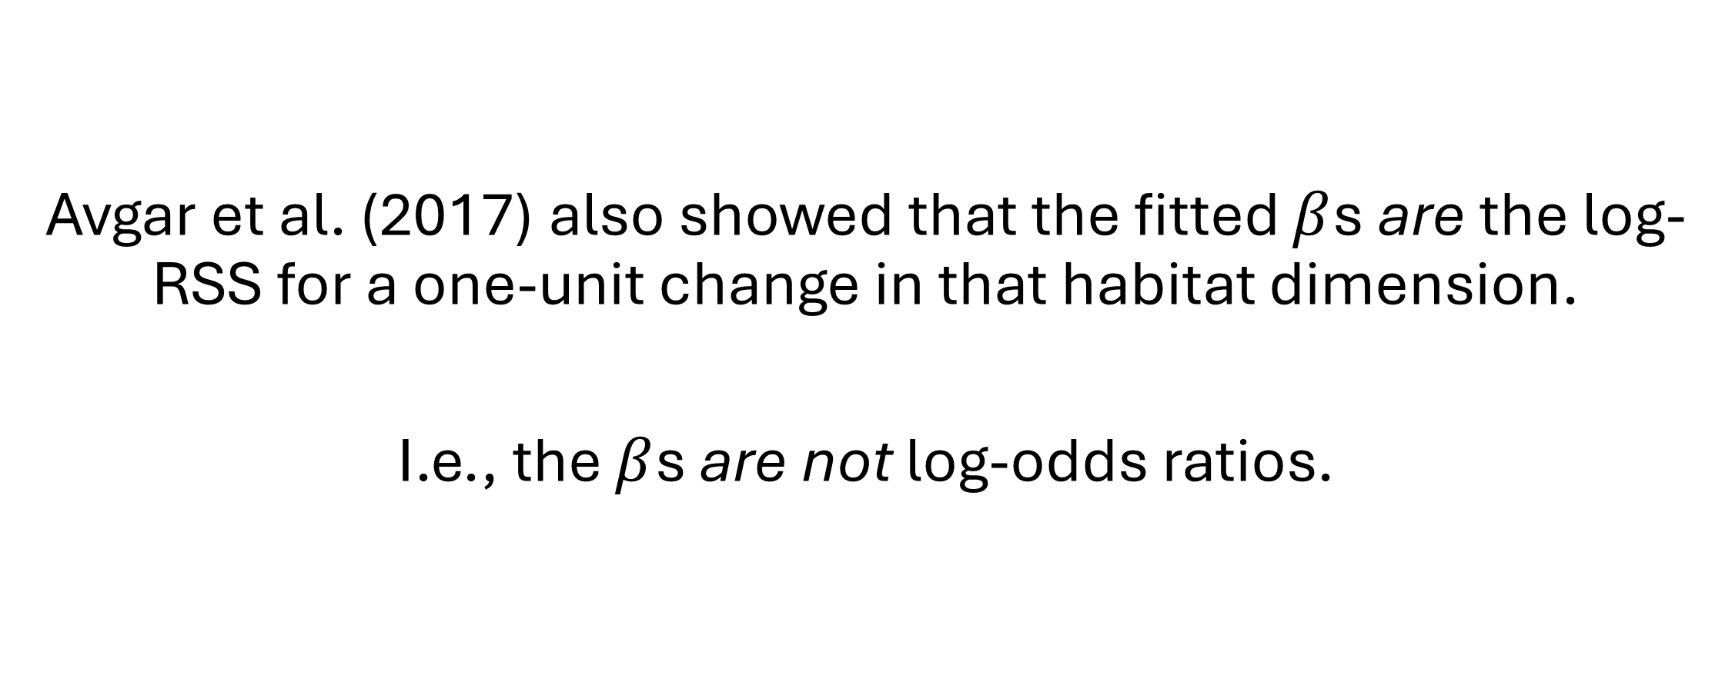
log-RSS
Avgar et al. (2017) also showed that the fitted $β$s are the log-RSS for a one-unit change in that habitat dimension.
I.e., the $β$s are not log-odds ratios.

Slide 78
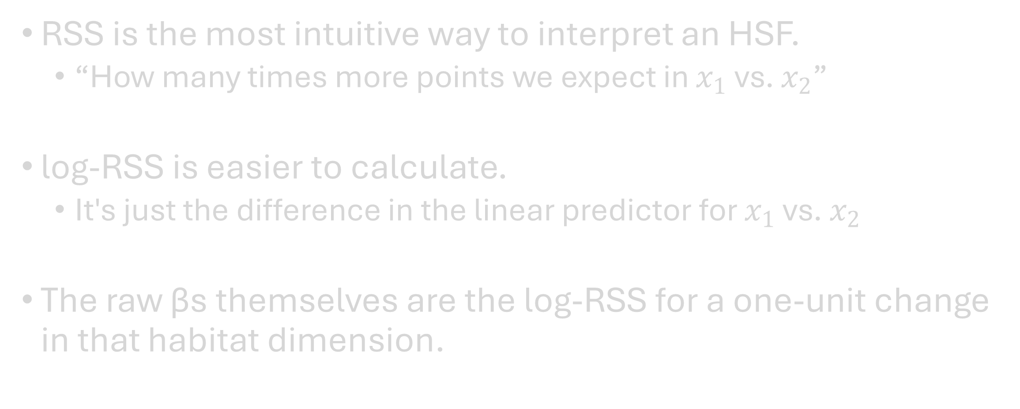
Take-home Points
RSS is the most intuitive way to interpret an HSF.
“How many times more points we expect in $x_{1}$ vs. $x_{2}$”
log-RSS is easier to calculate.
It's just the difference in the linear predictor for $x_{1}$ vs. $x_{2}$
The raw βs themselves are the log-RSS for a one-unit change in that habitat dimension.

Slide 79
Questions?
Notes:
<11:00 break>
<onto the RSF code walkthrough>

Slide 80
Movement Models
Notes:
<1:30 – 2:00>
We’re switching gears entirely right now, thinking not about habitat selection, but about movement

Slide 81

Continuous vs. Discrete Time
“Moving animals trace continuous paths through space. However, in order to record and analyze the pattern of their movement the essential characteristics of an observed path have to be represented in a discrete form suitable for computer storage and analysis... Note that this empirical approach to representing paths fits well with the theoretical framework of discrete random walks.”
— Turchin 1998, p. 128

Slide 82
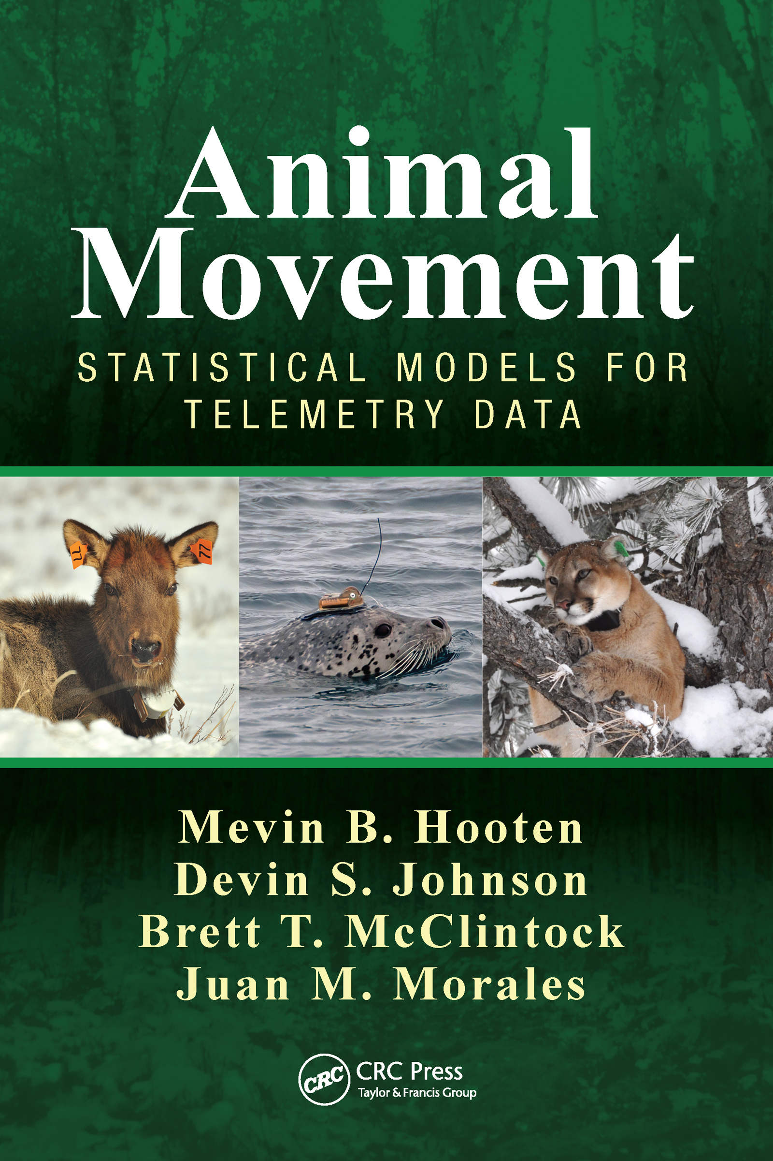
Continuous vs. Discrete Time
“The discrete-time context is valuable because (1) a wealth of tools can be borrowed from the time series literature, (2) the dynamics are easily conceptualized in discrete time, and finally, (3) we are implementing models digitally on computers, thus we must discretize ... One could argue, however, that the true process of movement really occurs in both continuous time and continuous space.”
— Hooten et al. 2017, p. 189

Slide 83
Notes:
We know that animals move in continuous time and can trace complex paths through their environment.

Slide 84
Notes:
We also know that our telemetry devices take regular samples of that movement process.

Slide 85
Notes:
From those samples we can create steps in discrete time.

Slide 86
Notes:
But even though we don’t observed the underlying movements, we’re not trying to imply that our animal followed the straight lines between points.

Slide 87
How can we model how our samples arise from the underlying movement?

Slide 88
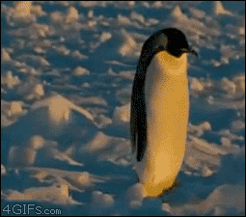
Random Walks
Random process that creates a path from a series of steps
Formulated in continuous time
Differential equations (calculus!)
Formulated in discrete time
Difference equations

Slide 89
Classifying Random Walks
Simple (pure) random walk (RW)
Correlated random walk (CRW)
Biased random walk (BRW)
Biased correlated random walk (BCRW)
Notes:
This is true for continuous time or discrete time random walks

Slide 90
Simple Random Walk (RW)
Positions are a first-order Markov process
Next position (t+1) depends only on current position (t)
Steps are non-Markovian
Each step is independent
Approximates Brownian motion
(see Codling et al. 2008)

Slide 91
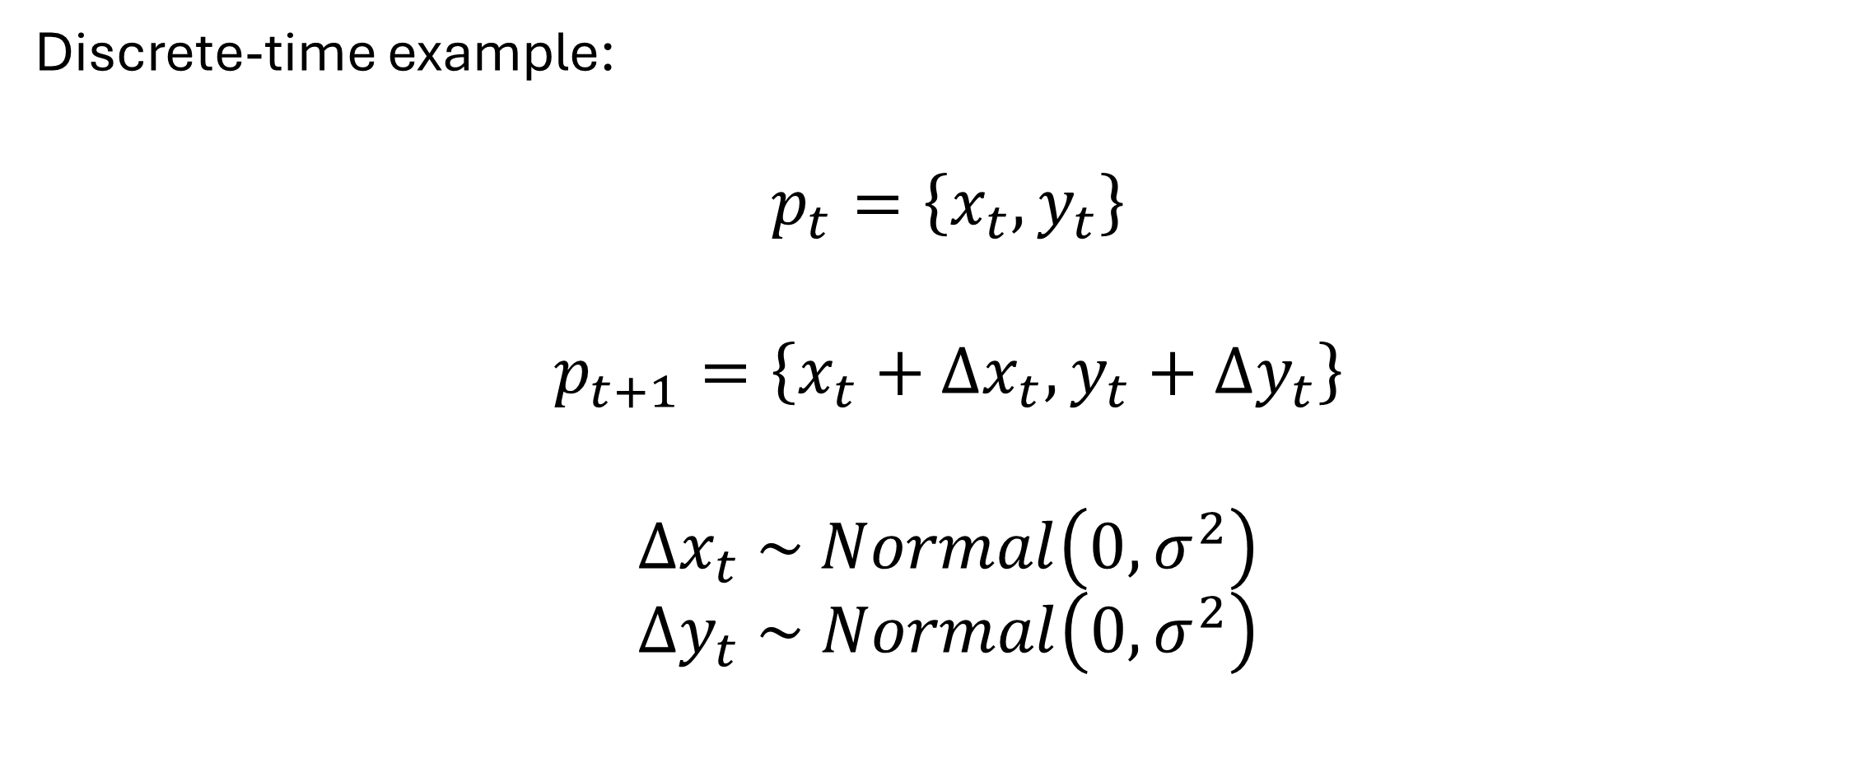
Simple Random Walk (RW)
Discrete-time example:
$$p_{t}=\left\{x_{t}, y_{t}\right\}$$
$$p_{t+1}=\left\{x_{t}+Δx_{t}, y_{t}+Δy_{t}\right\}$$
$$Δx_{t} \sim Normal\left(0, σ^{2}\right)$$
$$Δy_{t} \sim Normal\left(0, σ^{2}\right)$$
Notes:
Position (p) at time t is given by an x-coordinate and a y-coordinate
So here, we’re just adding some amount (positive or negative) to the x-coordinate and the y-coordinate.
This example will result in a distribution of expected p at any t that comes from a bivariate normal distribution.

Slide 92







Simple Random Walk (RW)
Discrete-time example:
$$Δx_{t} \sim Normal\left(0, σ^{2}\right)$$
$$Δy_{t} \sim Normal\left(0, σ^{2}\right)$$
$$l_{t}=\sqrt{Δx_{t}^{2}+Δy_{t}^{2}}$$
$$θ_{t}=arctan2\left(Δ_{y}, Δ_{x}\right)$$
$$p_{t+1}$$
$$l_{t}$$
random
$$Δy_{t}$$
$$θ_{t}$$
$$p_{t}$$
$$Δx_{t}$$
calculate
Notes:
That looks something like this.
We can then calculate the step length and heading using trig.
These are planar coordinates

Slide 93

Simple Random Walk (RW)
Alternative Parameterization:
$$l_{t} \sim gamma\left(α, β\right)$$
$$θ_{t}\sim von Mises\left(μ, κ\right)$$
$$Δx_{t}=l_{t}\cos\left(θ_{t}\right)$$
$$Δy_{t}=l_{t}\sin\left(θ_{t}\right)$$
$$p_{t+1}$$
$$l_{t}$$
random
$$Δy_{t}$$
$$θ_{t}$$
$$p_{t}$$
$$Δx_{t}$$
calculate
Notes:
Alternatively, we can model step length and turn angle as the random quantities.
And we can calculate Delta x and Delta y using trig.
These are polar coordinates instead of planar coordinates.

Slide 94
Correlated Random Walk (CRW)
Positions are a second-order Markov process
Next position (t+1) depends on current position (t) and previous position (t-1)
Steps are a first-order Markov process
Each step is correlated with the previous step (first-order)

Slide 95








Correlated Random Walk (CRW)
$$l_{t}$$
Discrete time example:
(Use polar coordinates)
$$l_{t} \sim gamma\left(α, β\right)$$
$$Δθ_{t} \sim von Mises\left(μ, κ\right)$$
$$θ_{t}=θ_{t−1}+Δθ_{t}$$
$$p_{t+1}$$
$$θ_{t−1}$$
$${Δθ}_{t}$$
$$θ_{t}$$
random
$$p_{t}$$
calculate
$$p_{t−1}$$
Notes:
The step length is still random.
Now the change in heading is the random quantity. I’ll call this a turn angle. The difference in angle from if you had gone straight.
We sum the previous heading and the turn angle to get the new heading.

Slide 96
Biased Random Walk (BRW)
Positions are a first-order Markov process
Next position (t+1) depends only on current position (t)
Steps are non-Markovian
Each step is independent
Some preferred heading

Slide 97
Biased Random Walk (BRW)
Locally Biased
Globally Biased
Attraction to a place
Heading changes with position
Attraction to a heading
Equivalent to attraction to a place infinitely far away

Slide 98
Biased Random Walk (BRW)
Locally Biased
Attraction to a place
Heading changes with position
Notes:
With local bias, as the animal moves, the heading of the bias changes (the dotted lines point at a different angle)

Slide 99
Biased Random Walk (BRW)
Globally Biased
Attraction to a heading
Equivalent to attraction to a place infinitely far away
Notes:
With global bias, as the animal moves, the heading of the bias DOES NOT change (the dotted lines point at the same angle)

Slide 100
Biased Correlated Random Walk (BCRW)
Positions are a second-order Markov process
Next position (t+1) depends on current position (t) and previous position (t-1)
Steps are a first-order Markov process
Each step is correlated with the previous step (first-order)
Some preferred heading
Notes:
Combination of the tendency to head in the same direction and a tendency toward a local or global bias

Slide 101

SSFs are BCRWs!
Notes:
Local bias induced by habitat selection!

Slide 102
Take Home Points
Random walks are mathematical descriptions of a stepwise process that results in a movement path.
Random walks can be classified by whether they exhibit correlation (directional persistence) or bias (preferred heading).
Locally biased random walks can be used to model an animal that selects habitat.
Notes:
<2:00, break>

Slide 103
Step Selection Functions
Notes:
<2:00 – 2:45>

Slide 104
Roadmap
Movement Models
RSFs
(aka HSFs)
(i)SSFs
Notes:
We’ve covered HSFs and movement, now let’s put them together to understand SSFs.

Slide 105
HSFs
Notes:
We’ve seen that the generating model for HSFs assumes completely independent points.
(Figure from the HSF code walkthrough)

Slide 106
Notes:
But we’ve also seen that modern telemetry datasets are high resolution samples from a continuous movement process. This results in strong spatiotemporal autocorrelation.

Slide 107
Notes:
The result is that it’s not reasonable to assume that all locations are equally available at all times.
Given what we know about animal movement, is it reasonable to assume that in the next observation – a short time later – that it’s equally likely to be at either of these available locations?

Slide 108

Timeline
Manly et al. 1993
Arthur et al. 1996
1995
2000
2005
2010
2015
2020
2024
Aebischer et al. 1993
Notes:
Arthur et al. (1996) presented what would become known as discrete choice RSFs.

Slide 109
Discrete Choice RSF
Availability changes with discrete time periods
Pair used points with correct available set
Simplest analysis:
Few discrete periods
Fit an RSF for each time period
SUMMER
FALL
SPRING
WINTER
Notes:
Allows temporally changing availability

Slide 110
Discrete Choice RSF
Availability changes with discrete time periods
Pair used points with correct available set
Simplest analysis:
Few discrete periods
Fit an RSF for each time period
Better analysis:
Discrete period for each used location
Fit a single conditional RSF to all periods
Conditional logistic regression
SUMMER
FALL
SPRING
WINTER
Notes:
Conditional logistic regression finds parameters that maximize likelihood within all strata (kind of like the average across all strata)
One set of selection coefficients.

Slide 111
Discrete Choice RSF
Notes:
Three used points

Slide 112
Discrete Choice RSF
Notes:
Define a radius of availability
Something like the maximum distance the animal might travel between locations

Slide 113
Discrete Choice RSF
Notes:
Randomly sample available points within the domain (uniform density)

Slide 114
Discrete Choice RSF
Notes:
The problem with uniform sampling in this domain is that there is more area far from the used point than close to the used point.
If these were possible movements, then this implies an unrealistic movement model, where long steps are more likely than short steps.

Slide 115

Timeline
Manly et al. 1993
Arthur et al. 1996
1995
2000
2005
2010
2015
2020
2024
Fortin et al. 2005
Aebischer et al. 1993
Notes:
Fortin addressed this problem by introducing SSFs

Slide 116
SSFs
Treat the step as the unit of analysis
(rather than the point)
Sample available steps from the observed distributions of step lengths and turn angles
Allows for a CRW
Fit SSF using conditional logistic regression

Slide 117
SSFs
Notes:
Here are the data

Slide 118
SSFs
Turn Angle
Step Length
Notes:
We measure the step lengths and turn angles for the observed data

Slide 119
SSFs
Notes:
And we use those empirical distributions to sample random step lengths and turn angles to create available steps
We fit the model with conditional logistic regression, just like the discrete choice RSF.
But here, we have a sensible movement model.

Slide 120

Timeline
Manly et al. 1993
Forester et al. 2009
Arthur et al. 1996
1995
2000
2005
2010
2015
2020
2024
Fortin et al. 2005
Aebischer et al. 1993
Notes:
But Forester et al. (2009) pointed out a problem with SSFs.
They showed that the empirical movement distributions depend strongly on habitat selection, so the habitat selection signal is already in the sampled available steps.
This leads to a bias in the estimation of the habitat selection coefficients

Slide 121
Forester et al. (2009)
Observed movement metrics are strongly influenced by habitat selection
Available steps of Fortin et al. (2005) already have a signal of habitat selection.
Thus, habitat selection parameters are estimated with bias

Slide 122
Forester et al. (2009)
The solution?
Parameterize an independent movement model
“Resource-independent sampling function”
Include functions of step length as a predictor in the model
Notes:
I will refer to the “resource-independent sampling function” as a “selection-free movement kernel”
This removes the bias in the coefficients, but it still treats movement like a nuisance and habitat selection as the quantity of interest.

Slide 123

Timeline
Manly et al. 1993
Forester et al. 2009
Arthur et al. 1996
1995
2000
2005
2010
2015
2020
2024
Fortin et al. 2005
Avgar et al. 2016
Aebischer et al. 1993
Notes:
Building off the ideas of Forester et al. (2009), Avgar et al. (2016) developed iSSA.

Slide 124
iSSFs
Integrated estimation of habitat selection and movement
Inference on habitat selection and movement
Fit the models using conditional logistic regression, making the method widely available without writing custom likelihoods
Notes:
Integrated estimation of movement and habitat had been done before, but required custom models.

Slide 125
SSF vs. iSSF
SSF
iSSF
Sample available steps from empirical distribution
Make inference only on habitat selection
HS parameters biased
Sample available steps from a parametric distribution
Make inference on habitat selection and movement
Lends itself to prediction

Slide 126

Prediction from Fitted iSSF
Notes:
There are really powerful tings you can do with this – see this excellent review for details on concept and approach.

Slide 127

Prediction from Fitted iSSF
Notes:
We’re not going to cover how to do this, but see our recent paper for details of the implementation in ‘amt’

Slide 128


iSSF
Parameterizes two independent functions (aka, kernels)
Movement-free habitat selection kernel $\left(w\left(∙\right)\right)$
Selection-free movement kernel $\left(φ\left(∙\right)\right)$
iSSF is the (normalized) product of these two $\left(u\left(∙\right)∝w\left(∙\right)φ\left(∙\right)\right)$
Fig. 1 from Michelot et al. (2024)
Notes:
u() is often called a redistribution kernel more generally

Slide 129
iSSF Parametric Distributions
Step Length
Turn Angle
Exponential
Gamma
Half-normal
Log-normal
Weibull
Uniform
von Mises
Wrapped Cauchy
Notes:
All of these distributions are exponential family
Weibull and wrapped Cauchy are commonly used in movement modeling, but they are not from the exponential family

Slide 130
iSSA Steps
Create observed steps from point data
Notes:
It is important the observed steps have a reasonably constant duration $\left(Δt\right)$

Slide 131
iSSA Steps
Create observed steps from point data
Propose “tentative distributions” for step length and turn angle
Usually by fitting to observed distributions
Notes:
Conditional on $Δt$

Slide 132
iSSA Steps
Create observed steps from point data
Propose “tentative distributions” for step length and turn angle
Usually by fitting to observed distributions
Sample random available steps from tentative distributions

Slide 133
iSSA Steps
Create observed steps from point data
Propose “tentative distributions” for step length and turn angle
Usually by fitting to observed distributions
Sample random available steps from tentative distributions
Attach environmental covariates to all observed and available steps

Slide 134
iSSA Steps
Create observed steps from point data
Propose “tentative distributions” for step length and turn angle
Usually by fitting to observed distributions
Sample random available steps from tentative distributions
Attach environmental covariates to all observed and available steps
Fit conditional logistic regression model
Include step length and turn angle predictors

Slide 135
iSSA Steps
Create observed steps from point data
Propose “tentative distributions” for step length and turn angle
Usually by fitting to observed distributions
Sample random available steps from tentative distributions
Attach environmental covariates to all observed and available steps
Fit conditional logistic regression model
Include step length and turn angle predictors
Interpret model
Interpret habitat selection coefficients with (log-)RSS
Update tentative distribution with step length and turn angle coefficients

Slide 136

Updating Movement Kernel
Gamma distribution:
$$l_{tent} \sim gamma\left(k_{tent}, q_{tent}\right)$$
$${\hat{l}}_{upd} \sim gamma\left({\hat{k}}_{upd}, {\hat{q}}_{upd}\right)$$
$${\hat{k}}_{upd}=k_{tent}+{\hat{β}}_{\ln\left[l\right]}$$
$${\hat{q}}_{upd}=\frac{1}{\frac{1}{q_{tent}}−{\hat{β}}_{l}}$$
Fieberg et al. 2021 Appendix C
Notes:
If available step lengths were sampled from a gamma distribution (parameterized by shape and scale), then here are the formulas to update the shape and scale parameters.
Should have included ln(step length) and step length as covariates in the model.
See Fieberg et al. (2021) Appendix C for all the formulas
You don’t need to remember these – software (e.g., amt) will do it for you!

Slide 137

Updating Movement Kernel
von Mises distribution:
$$θ_{tent} \sim von Mises\left(μ_{tent}, ν_{tent}\right)$$
$${\hat{θ}}_{upd} \sim von Mises\left(μ_{tent}, {\hat{ν}}_{upd}\right)$$
$${\hat{ν}}_{upd}=ν_{tent}+{\hat{β}}_{\cos\left[θ\right]}$$
Fieberg et al. 2021 Appendix C
Notes:
If available turn angles were sampled from a von Mises distribution (parameterized by mean and concentration), then here are the formulas to update the concentration parameter (mean cannot be updated).
Should have included cos(turn angle) as covariate in the model.
See Fieberg et al. (2021) Appendix C for all the formulas

Slide 138

Interactions between Movement and Habitat
Fieberg et al. (2021) Appendix B
Notes:
By including interactions between movement and habitat in our iSSFs, we can model different movement processes depending on the location.
This is an example with a discrete habitat variable.

Slide 139

Interactions between Movement and Habitat
Fieberg et al. (2021) Appendix B
Notes:
This is an example with a continuous habitat variable (even though the figure shows discrete categories, the model was fit with a continuous variable).

Slide 140

Timeline
Fithian & Hastie 2013
Manly et al. 1993
Forester et al. 2009
Michelot et al. 2024
Arthur et al. 1996
1995
2000
2005
2010
2015
2020
2024
Fortin et al. 2005
Avgar et al. 2016
Aebischer et al. 1993
Warton & Shepherd 2010
Notes:
One last stop on our timeline.
Earlier this year, Michelot et al. showed us how sampling available steps is equivalent to known numerical integration techniques.

Slide 141

Michelot et al. 2024
Showed that iSSA uses importance sampling for numerical integration
Fig. 3 from Michelot et al. (2024)
Notes:
These ideas are not necessarily new, but they were presented in an accessible way with an emphasis on the underlying model.

Slide 142

Michelot et al. 2024
Fig. 5 from Michelot et al. (2024)
Notes:
The most important point (I think) is to separate the underlying model (“model formulation”) from the method for fitting it (“inference”).

Slide 143
iSSF Parametric Distributions
Step Length
Turn Angle
Exponential
Gamma
Half-normal
Log-normal
Weibull
Uniform
von Mises
Wrapped Cauchy
Notes:
With iSSA, we cannot use Weibull and wrapped Cauchy (or many others)

Slide 144
SSF with Numerical Integration
Step Length
Turn Angle
Exponential
Gamma
Half-normal
Log-normal
Weibull
Uniform
von Mises
Wrapped Cauchy
Notes:
But with the methods of Michelot, we can use any distributions we like.

Slide 145
Take Home Points
Useful to have habitat selection models that can:
accommodate changing availability over time.
account for the sequential movement process.
SSFs accomplish this by:
treating the step as the unit of analysis.
accounting for movement and habitat selection.
Ordinary SSFs are biased by assuming the movement kernel is known
Estimate movement with iSSA or another numerical integration approach
Notes:
<~2:45 – switch rooms by 3:00>

Slide 146
Literature Cited/Further Reading
Aebischer, N.J., Robertson, P.A. & Kenward, R.E. (1993). Compositional Analysis of Habitat Use From Animal Radio‐Tracking Data. Ecology, 74, 1313–1325.
Arthur, S.M., Manly, B.F.J., McDonald, L.L. & Gerald, W. (1996). Assessing Habitat Selection when Availability Changes, 77, 215–227.
Avgar, T., Deardon, R. & Fryxell, J.M. (2013a). An empirically parameterized individual based model of animal movement, perception, and memory. Ecological Modelling, 251, 158–172.
Avgar, T., Lele, S.R., Keim, J.L. & Boyce, M.S. (2017). Relative Selection Strength: Quantifying effect size in habitat- and step-selection inference. Ecology and Evolution, 7, 5322–5330.
Avgar, T., Mosser, A., Brown, G.S. & Fryxell, J.M. (2013b). Environmental and individual drivers of animal movement patterns across a wide geographical gradient. Journal of Animal Ecology, 82, 96–106.
Avgar, T., Potts, J.R., Lewis, M.A. & Boyce, M.S. (2016). Integrated step selection analysis: bridging the gap between resource selection and animal movement. Methods in Ecology and Evolution, 7, 619–630.
Codling, E.A., Plank, M.J. & Benhamou, S. (2008). Random walk models in biology. Journal of the Royal Society Interface, 5, 813–834.
DeCesare, N.J., Hebblewhite, M., Schmiegelow, F., Hervieux, D., McDermid, G.J., Neufeld, L., et al. (2012). Transcending scale dependence in identifying habitat with resource selection functions. Ecological Applications, 22, 1068–1083.
Dickie, M., McNay, S.R., Sutherland, G.D., Cody, M. & Avgar, T. (2020). Corridors or risk? Movement along, and use of, linear features varies predictably among large mammal predator and prey species. Journal of Animal Ecology, 89, 623–634.
Fieberg, J., Signer, J., Smith, B. & Avgar, T. (2021). A “How to” guide for interpreting parameters in habitat-selection analyses. Journal of Animal Ecology, 90, 1027–1043.
Fithian, W. & Hastie, T. (2013). Finite-sample equivalence in statistical models for presence-only data. Annals of Applied Statistics, 7, 1917–1939.
Fortin, D., Beyer, H.L., Boyce, M.S., Smith, D.W., Duchesne, T. & Mao, J.S. (2005). Wolves influence elk movements: Behavior shapes a trophic cascade in Yellowstone National Park. Ecology, 86, 1320–1330.
Hodel, F.H. & Fieberg, J.R. (2022). Circular–linear copulae for animal movement data. Methods Ecol Evol, 13, 1001–1013.
Hooten, M.B., Hanks, E.M., Johnson, D.S. & Alldredge, M.W. (2013). Reconciling resource utilization and resource selection functions. Journal of Animal Ecology, 82, 1146–1154.
Hooten, M.B., Johnson, D.S., McClintock, B.T. & Morales, J.M. (2017). Animal Movement: Statistical Models for Telemetry Data. CRC Press, Boca Raton.
Johnson, D.H. (1980). The Comparison of Usage and Availability Measurements for Evaluating Resource Preference. Ecology, 61, 65–71.
Johnson, D.S., Hooten, M.B. & Kuhn, C.E. (2013). Estimating animal resource selection from telemetry data using point process models. Journal of Animal Ecology, 82, 1155–1164.

Slide 147
Literature Cited/Further Reading
Klappstein, N., Michelot, T., Fieberg, J., Pedersen, E., Field, C. & Flemming, J.M. (2024). Step selection analysis with non-linear and random effects in mgcv.
Lele, S.R., Merrill, E.H., Keim, J. & Boyce, M.S. (2013). Selection, use, choice and occupancy: clarifying concepts in resource selection studies. Journal of Animal Ecology, 82, 1183–1191.
Manly, B.F.J., McDonald, L.L., Thomas, D.L., McDonald, T.L. & Erickson, W.P. (2002). Resource Selection by Animals. Springer Netherlands, Dordrecht, The Netherlands.
Matthiopoulos, J., Fieberg, J. & Aarts, G. (2020). Species-Habitat Associations: Spatial data, predictive models, and ecological insights. University of Minnesota Libraries Publishing. First Edition.
Matthiopoulos, J., Fieberg, J. & Aarts, G. (2023). Species-Habitat Associations: Spatial data, predictive models, and ecological insights. Second Edition. University of Minnesota Libraries Publishing. Second Edition.
Matthiopoulos, J., Fieberg, J.R., Aarts, G., Beyer, H.L., Morales, J.M. & Haydon, D.T. (2015). Establishing the link between habitat selection and animal population dynamics. Ecological Monographs, 85, 413–436.
Matthiopoulos, J., Field, C. & MacLeod, R. (2019). Predicting population change from models based on habitat availability and utilization. Proceedings of the Royal Society B: Biological Sciences, 286.
Michelot, T., Klappstein, N.J., Potts, J.R. & Fieberg, J. (2024). Understanding step selection analysis through numerical integration. Methods Ecol Evol, 15, 24–35.
Muff, S., Signer, J. & Fieberg, J.R. (2020). Accounting for individual-specific variation in habitat-selection studies: Efficient estimation of mixed-effects models using Bayesian or frequentist computation. Journal of Animal Ecology, 89, 80–92.
Northrup, J.M., Vander Wal, E., Bonar, M., Fieberg, J., Laforge, M.P., Leclerc, M., et al. (2022). Conceptual and methodological advances in habitat‐selection modeling: guidelines for ecology and evolution. Ecological Applications, 32, e02470.
Picardi, S., Coates, P., Kolar, J., O’Neil, S., Mathews, S. & Dahlgren, D. (2021). Behavioural state-dependent habitat selection and implications for animal translocations. Journal of Applied Ecology, 1–12.
Potts, J.R. & Börger, L. (2022). How to scale up from animal movement decisions to spatiotemporal patterns: An approach via step selection. Journal of Animal Ecology, 1365-2656.13832.
Potts, J.R., Börger, L., Strickland, B.K. & Street, G.M. (2022). Assessing the predictive power of step selection functions: how social and environmental interactions affect animal space use. Methods in Ecology and Evolution, 1–39.

Slide 148
Literature Cited/Further Reading
Rosenzweig, M.L. (1981). A Theory of Habitat Selection. Ecology, 62, 327–335.
Rosenzweig, M.L. (1991). Habitat Selection and Population Interactions: The Search for Mechanism. The American Naturalist, 137, S5–S28.
Schlägel, U.E., Signer, J., Herde, A., Eden, S., Jeltsch, F., Eccard, J.A., et al. (2019). Estimating interactions between individuals from concurrent animal movements. Methods in Ecology and Evolution, 10, 1234–1245.
Signer, J., Fieberg, J., Reineking, B., Schlägel, U., Smith, B., Balkenhol, N., et al. (2024). Simulating animal space use from fitted integrated Step‐Selection Functions (iSSF). Methods Ecol Evol, 15, 43–50.
Signer, J., Fieberg, J.R. & Avgar, T. (2017). Estimating utilization distributions from fitted step-selection functions. Ecosphere, 8, e01771.
Signer, J., Fieberg, J.R. & Avgar, T. (2019). Animal movement tools (amt): R package for managing tracking data and conducting habitat selection analyses. Ecology and Evolution, 9, 880–890.
Tilman, D. (1980). Resources: A Graphical-Mechanistic Approach to Competition and Predation. The American Naturalist, 116, 362–393.
Turchin, P. (1998). Quantitative Analysis of Movement: Measuring and Modeling Population Redistribution in Animals and Plants. Sinauer Press, Sunderland, MA.
Warton, D.I. & Shepherd, L.C. (2010). Poisson point process models solve the “pseudo-absence problem” for presence-only data in ecology. Annals of Applied Statistics, 4, 1383–1402.

